Slide 1
Heart disease
By Jack Gardner
and Billy Adamson

Slide 2
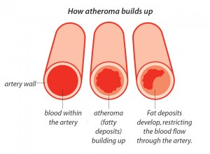
Atheroma
Atheroma is the cause of various cardiovascular diseases such as thrombosis, heart attack, stroke and aneurisms.
Risk factors
Age
Diet
Amount of exercise
Smocking
An atheroma is an build up of material in the inner layer of artery walls. The material is made predominantly of macrophage cells, calcium and lipids. The build up of material of the artery wall, will cause narrowing and a restricting blood flow.

Slide 3
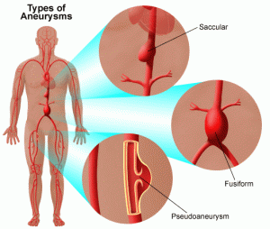
Aneurism
An aneurism is a blood-filled balloon-like bulge in the wall of a blood vessel.
Risk factors
Age
Excessive alcohol consumption
Bad diet or a diet high in cholesterol
Obesity
Being diabetic
Having syphilis
How does an atheroma cause it?
An atheroma will cause weakness in an artery. This means that it will not be able to withstand the force of the blood causing it to buckle , especially if you suffer from high blood pressure

Slide 4
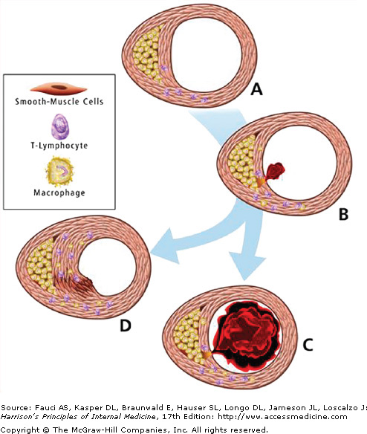
Thrombosis
Thrombosis is the formation of a blood clot inside a blood vessel, obstructing the flow of blood through the circulatory system, A clot that breaks free and begins to travel around the body is known as an embolus.
Risk factors
Genetics
Pregnancy
Smocking
Obesity
Prolonged bed rest
Age
Use of birth-control pills or hormone replacement therapy
How does an atheroma cause it?
Sometimes a patch of atheroma may develop a tiny crack or rupture on the inside surface of the blood vessel. This may trigger a blood clot to form over the atheroma, which may completely block the blood flow or detach and block somewhere further along.

Slide 5
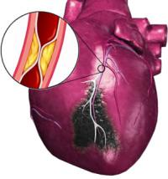
Myocardial infraction
Myocardial infarctio occurs when one of the coronary arteries or their branches undergo an obstruction causing the insufficient blood flow to a specific region of the heart.
Risk factors
Smocking
Bad diet
Drug use
Lack of exercise
High blood pressure
Ethnicity
Genetics
How can an atheroma cause it?
An atheroma in a coronary artery can severely weaken the artery wall, possibly causing a thrombus. Or it can cause an embolism which blocks a coronary artery
Thrombus
Atheroma

