Slide 1
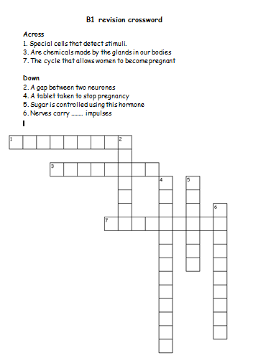
Can you complete the revision crossword?

Slide 2
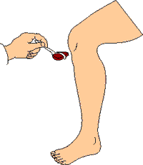
COORDINATION AND
CONTROL

Slide 3
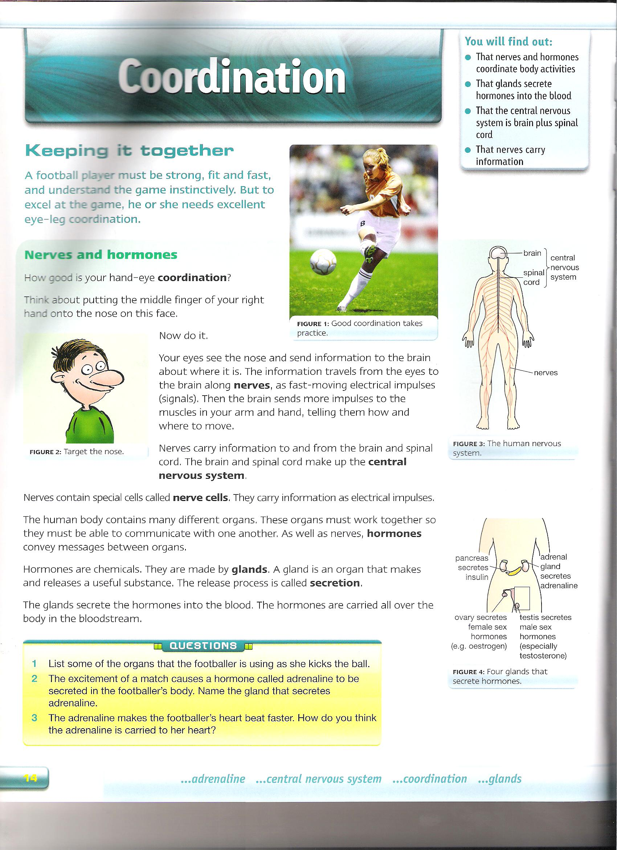
Nerves
The brain and spinal cord make up the central nervous system.
Nerves carry information as electrical impulses.

Slide 4
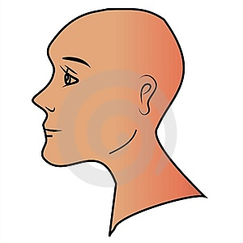
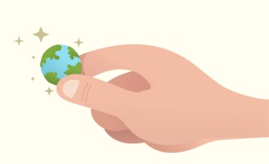
Receptors
Vision- eyes (light)
Receptors are special cells that detect stimuli.
Smell- nose (chemicals)
Stimulus is a change in the environment.
Receptors send electrical impulses along nerves to your brain.
Taste- tongue (chemicals)
Hearing – ears (sound and movement)
Your brain then sends impulses speeding along other nerves to a muscle e.g. in the hand or leg.
Touch- skin (temperature and pressure)
All your muscles are effectors. An effector is an organ that does something to respond to a stimulus.

Slide 5
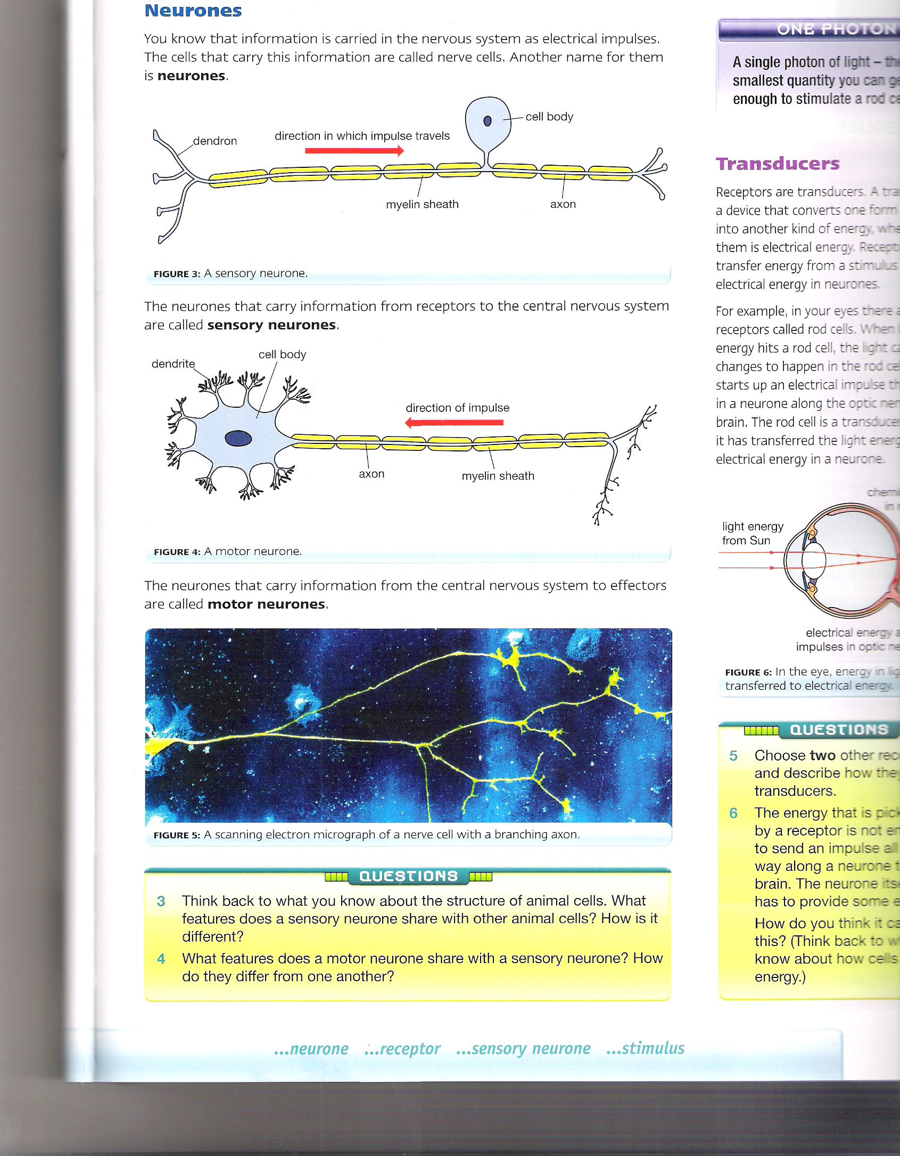
Neurones
Carry information from the nervous system as electrical impulses.
This is a sensory neurone.
It carries information from the receptor to the CNS.
This is a motor neurone.
It carries information from the CNS to the effector.

Slide 6
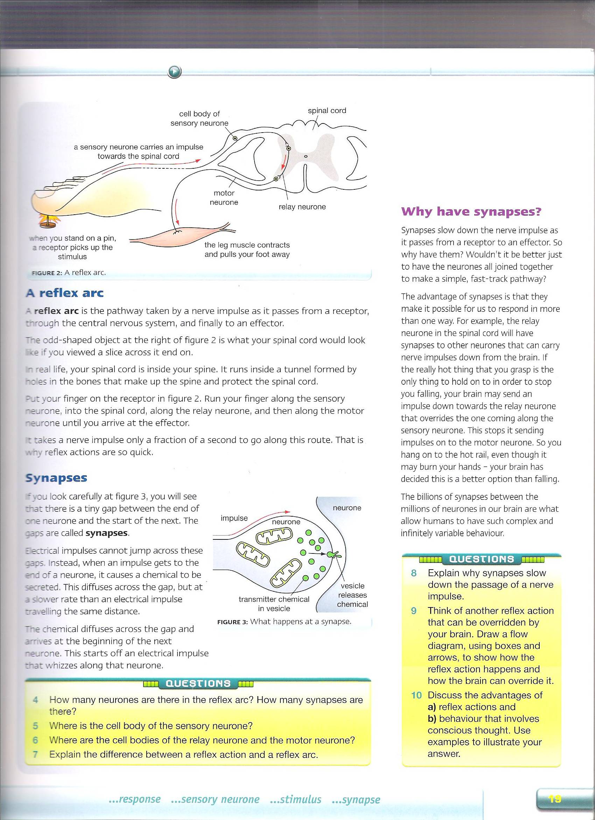
Reflex actions
In a reflex action:
A receptor detects a stimulus.
The tap on the knee in the knee jerk test is a stimulus.
Its detected by receptors in the thigh muscle connected to your knees.
The receptor sends electrical signals to your spinal cord.
The spinal cord sends nerve impulses to your leg muscles.
The leg muscles respond by contracting which pulls your lower leg upwards.
The receptor sends an electrical impulse along a sensory neurone
Synapse
Impulses travel in relay nerve in CNS.
Synapse
The CNS sends an electrical impulse along a motor neurone to an effector.
The effector responds to the stimulus.
A reflex action is a fast, automatic response to a stimulus.

Slide 7
Synapses
The tiny gap between the end of one neurone and the start of the next is a synapse.
Electrical impulses cannot jump across these gaps.
Instead when the impulse get to the end of the neurone, it causes a chemical to be secreted.
The chemical diffuses across the gap and arrives at the beginning of the next neurone.
This starts off an electrical impulse that whizzes along that neurone.

Slide 8
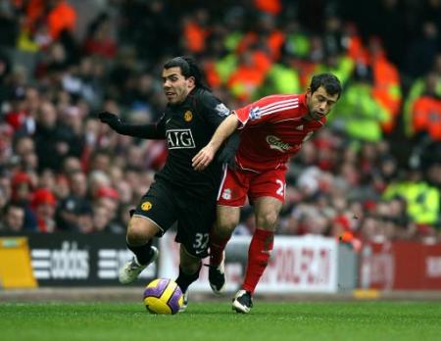
COORDINATION AND CONTROL

Slide 9
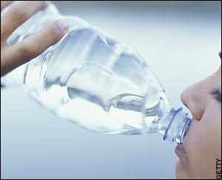
Water
Cells in your body are always working.
Chemical reaction take place inside them.
These need to happen at the right time and speed.
The conditions need to be perfect and constant.
These conditions include:
The water content
The ion (salt) content
The temperature
The concentration of sugar in blood
Your body can lose water:
From the lungs when you breathe.
From your skin when you sweat.
From the kidneys when you urinate.

Slide 10
Controlling water and ions:
The blood had many dissolved substances in it.
Some are ions such as sodium and chloride, both in salt.
To much salt and not enough water in the blood can lead to high blood pressure.
People who eat to much salt can increase risks of a heart attack.
The kidney helps keep balance of water and ions.
They do this by varying the amount of water and water from the body in urine.

Slide 11
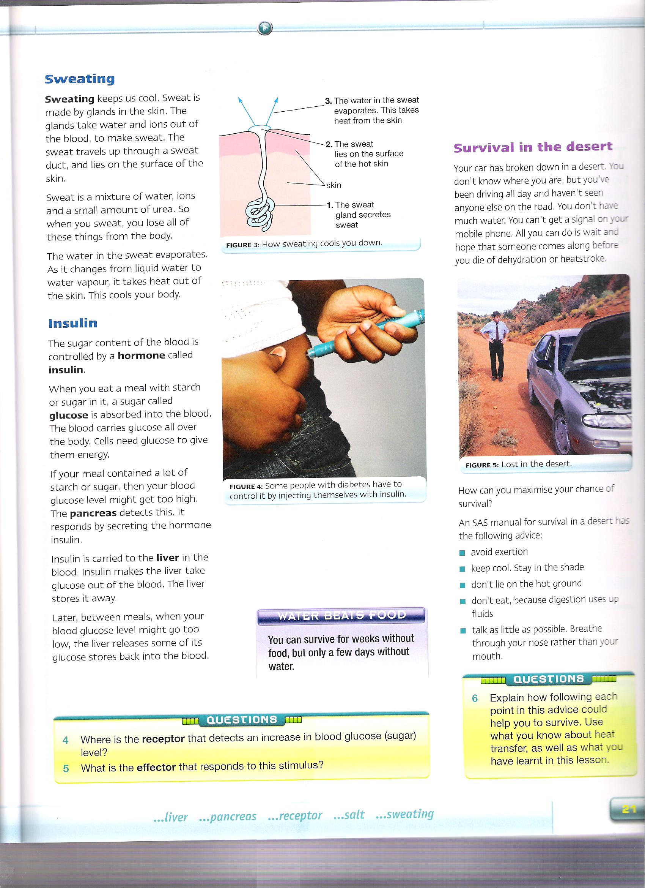
Sweating
It is made by glands in the skin.
The gland take water and ions out of the blood to make sweat.
The sweat travels through a sweat duct and lies on the surface of the skin.
It is a mixture of water, ions and small amounts of urea.
When you sweat you lose these.
The water in sweat evaporates.
As it changes from liquid water to water vapour, it takes out from the skin.
Sweating keeps us cool.

Slide 12
Hormones
The body contain lots of organs.
These organs work together to be able to communicate with one another.
Hormones convey messages between organs.
Hormones are chemicals made by the glands.
A gland is an organ that makes and releases useful substances. This is called secretion.
The gland secrete the hormones into the blood and carry throughout the bloodstream around the body.

Slide 13
Hormones and target organs:
Hormones also move around the body by blood vessels.
Most hormones affect a few organs and these are called target organs.
The hormone adrenaline has more target organs than most hormones.
Adrenaline affects the heart, breathing muscles, eyes and digestive system.

Slide 14
Insulin
Sugar content in the body is controlled by a hormone called insulin.
A meal with starch or sugar, a sugar called glucose is absorbed into the blood.
The blood carries this all over the body.
Cells need glucose for energy.
If a meals contains to much sugar or starch then the blood glucose level rises and the pancreas detects this.
It responds by excreting the hormone insulin.
This is carried to the liver in the blood.
The liver takes out glucose from the blood and stores it.
If your glucose levels fall then the liver stores this glucose back into the blood.

Slide 15
Menstrual cycle
The cycle, is when an egg is released from a woman's ovaries every 28 days.
Before the egg is released, the lining of the womb thickens.
If the egg is fertilised the womb is ready to conceive the tiny embryo.
If not the lining breaks down.
This passes through and is called menstruation.
The menstrual cycle is controlled by hormones:
FSH- secreted by the pituitary gland.
LH- secreted by the pituitary gland.
Oestrogen- secreted by the ovaries.
In the pituitary gland
In the ovary
FSH is secreted
FSH causes and egg to mature
FSH cause the ovary to secrete oestrogen
Oestrogen stops the pituitary secreting FSH
LH causes the mature egg to be released from the ovary
oestrogen cause the pituitary to secrete LH

Slide 16
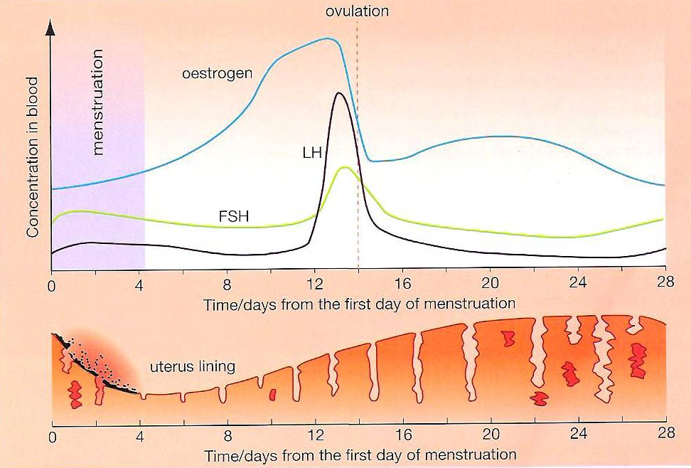
Hormones and menstrual cycle
Concentration of FSH, LH and Oestrogen change during the cycle.
As oestrogen levels rise they cause the thickness of the uterus lining.
As oestrogen levels fall, the lining breaks down.

Slide 17
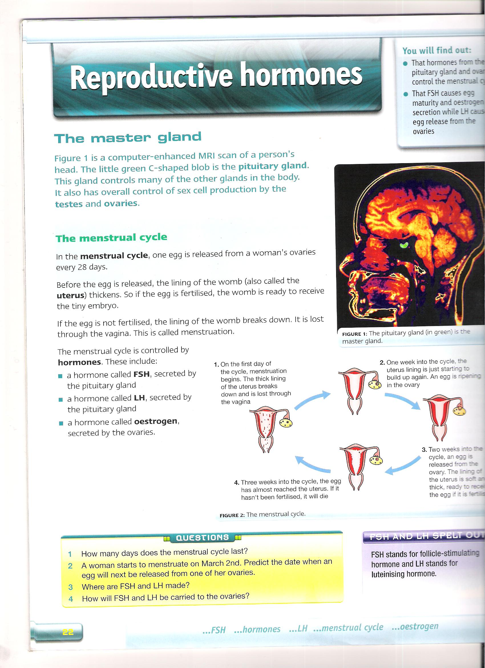
Hormones and menstrual cycle
1. On the first day of the cycle, menstruation begins. The thick lining of the uterus breaks down and is lost through the vagina.
2. One week into the cycle, the lining build up. An egg is ripening in the ovary.
Two weeks into the cycle, an egg is released from the ovary. The lining is soft and thick and ready to receive if egg is fertilised.
4. Three weeks into the cycle, the egg has almost reached the uterus. If it hasn’t been fertilised, it will die.

Slide 18
Controlling fertility
IVF- In Vitro Fertilisation
When a women doesn’t produce eggs, then she can be given fertility treatment.
The hormones used are called fertility drugs.
The hormone FSH, can used. This stimulates the women eggs to mature in the ovaries.
This egg is then released into the oviduct and conceive normally.
The women is given fertility drugs in her ovaries to mature the eggs.
These eggs are then removed and some are placed inside a Petri dish containing a special solution.
Then some of the mans sperm cells are added to this mixture.
These eggs can then fertilise, then when they form into tiny balls, the chosen embryos are then placed back into the women’s uterus.
Then if the process is successful a baby can develop.

Slide 19
Controlling fertility
Oral contraceptives
The contraceptive pill contains hormones such as oestrogen and progesterone.
This hormone stops the production of FSH, and then the eggs don’t mature in the ovaries.
So no egg in released into the ovaries and she cannot get pregnant.

Slide 20
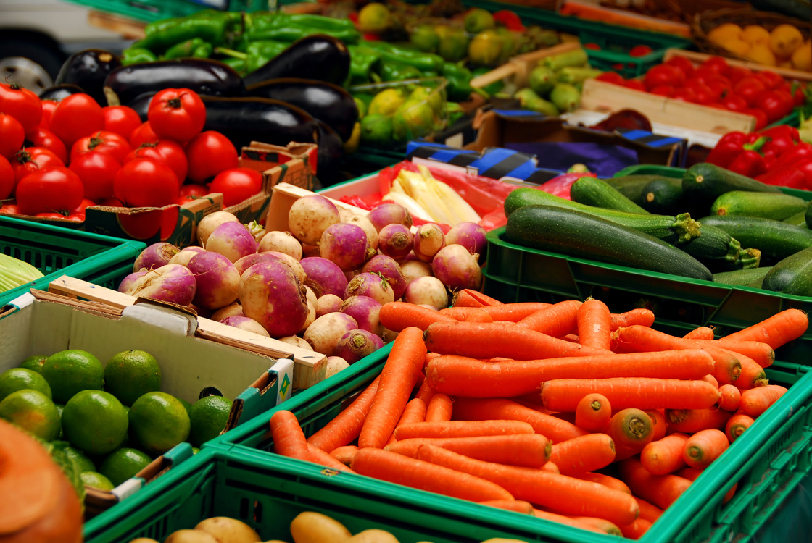
DIET &EXERCISE

Slide 21
Diet and Energy
Different people require different energy needs.
Exercise takes up lots of energy.
The amount of energy you need also depends on the type of job you do.
A balanced diet
Carbohydrates- for Energy
Fats – for stored energy and making cell membranes
Proteins- for growth and repair and energy
Another reason that affects the amount of food you eat is our metabolic rates.
All our metabolic rates are different.
Metabolic rate is the rate at which chemical reactions happen in the cells.
Men tend to have faster metabolic rates then women.
Young people have faster metabolic rates than older people.
The greater the proportion of muscle to fat in you body the higher your metabolic rate is.
It can also be affected by genes.
In winter people tend to have higher metabolic rates than in summer due to the less amount of food we need.
Vitamins and Minerals- for keeping healthy and not developing deficiency diseases
Fibre- to help the digestive system

Slide 22
FAT
We have fat in our bodies
It is found beneath the skin and around the organs, e.g. Kidneys
It is an energy store
It helps to insulate our bodies and keep heat in
It can protect internal organs from bruising

Slide 23
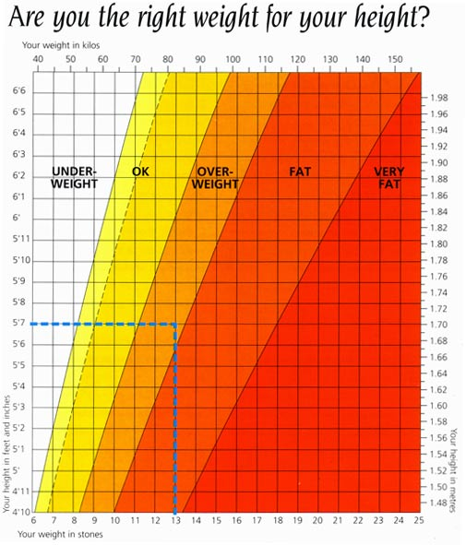
Obesity
The more food you eat each day, can lead to excess store of fat in the body
You need fat but to much is bad.
People who are overweight are called obese.
Being obese can lead to a high risk of being ill.
Problems include:
Arthritis
Diabetes
High blood pressure
Heart disease

Slide 24
Illnesses by obesity
Diabetes
An illness where a person cannot control their blood glucose level.
Type 2 is mostly suffered by obese people.
This is dangerous because you have to much glucose in the blood which can damage cells as it draws water out of them.
Arthritis
This is ‘inflammation of the joints’
High blood pressure
Blood pressure is the pressure of the blood in the arteries.
This is bad because it puts strain on the heart and their is an increases chance of blood vessels damaging.

Slide 25
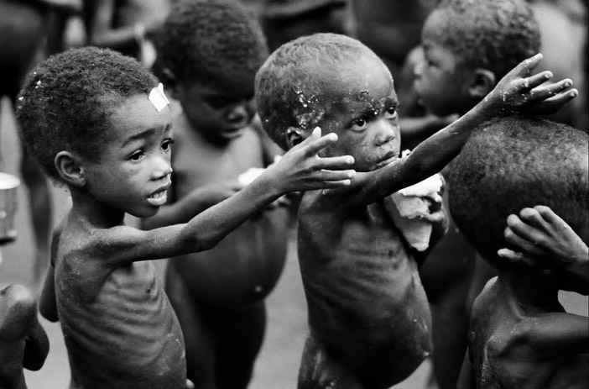
Starvation
When a person doesn’t have enough to eat:
their resistance to diseases is lowered.
They can die from diseases such as, cholera, tuberculosis.
Women’s periods become irregular or stop.
Malnutrition- diet is in adequate
In some countries, some people live by growing their own crops.
Sometimes they can be affected by:
Droughts or floods, so crops can’t grow properly.
A war, so people can’t visit their fields or look after their kids.
People are to poor to buy food.

Slide 26
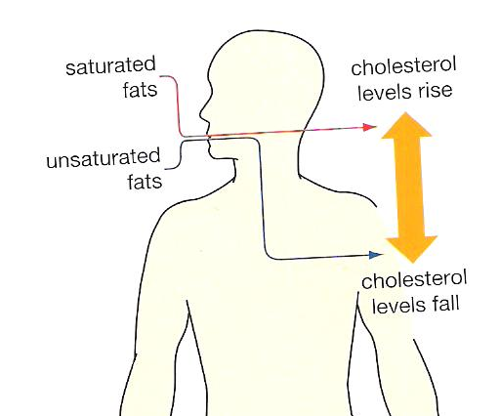
Cholesterol and Salt
Fast food contains lots of fat and salt.
Cholesterol
Too much cholesterol in the blood can form blockage in blood vessels and increased risk of heart disease.
Saturated fats are found in animal products e.g. Eggs, meat and dairy products.
Some fats lower your cholesterol levels. These are unsaturated fats, e.g. Plant oils ex sunflower oil.
Cholesterol can be used to make cell membranes e.g. Your liver makes cholesterol.
If you eat a diet with less saturated fats then your cell will have enough.
If you have too much then the liver makes less.
The amount of cholesterol you have depends on your genes and how much fat you eat.

Slide 27
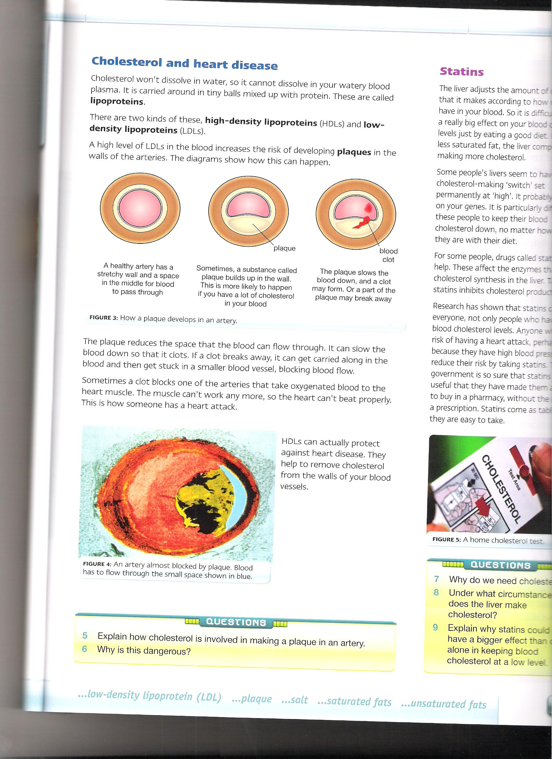
Cholesterol and heart disease
Cholesterol can’t dissolve in water, therefore it can’t dissolve into watery blood plasma.
Instead it is carried around in tiny ball mixed up with proteins called lipoproteins.
High density lipoproteins (HDLs)- is a good cholesterol and keeps you healthy.
Low density lipoproteins (LDLs)- is a bad cholesterol and can lead to heart disease.
High levels of LDLs in the blood can increase the risk of developing plaques in the wall of the arteries and can lead to heart problems
HDLs can protect us against heart disease. They help remove cholesterol from the walls of blood vessels.
The plaque reduces the space that blood can flow through.
It slows down the blood, so it clots.
If clots break away, they get carried along in the blood and get stuck in smaller blood vessels, blocking blood flow.
Sometimes a clot block one of the arteries that oxygenate blood to the heart muscle.
The muscle cant work, and the heart can’t beat properly.
This can cause a heart attack.

Slide 28
Different fats
Mono un-saturated fats- they reduce overall blood cholesterol levels and improve balance between LDLs and HDLs in the blood
Found in foods such as olive oil, olives, peanuts and many margarines
Saturated fats- raise blood cholesterol levels
Found in foods such as meat, butter and cheese.
Polyunsaturated fats- these are better at reducing blood cholesterol levels and balances HDLs and LDLs more that mono unsaturated.
Found in foods such as corn oil, sunflower oil, oily fish and many margarines.

Slide 29
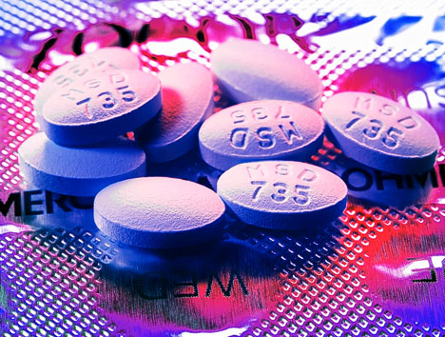
Statins
If a person’s liver seems to have their cholesterol making is permanently at high, then it is difficult fro them to keep cholesterol levels down.
They then have to take drugs called statins.
These affect the enzymes that control cholesterol synthesis in the liver and inhibits cholesterol production.

Slide 30
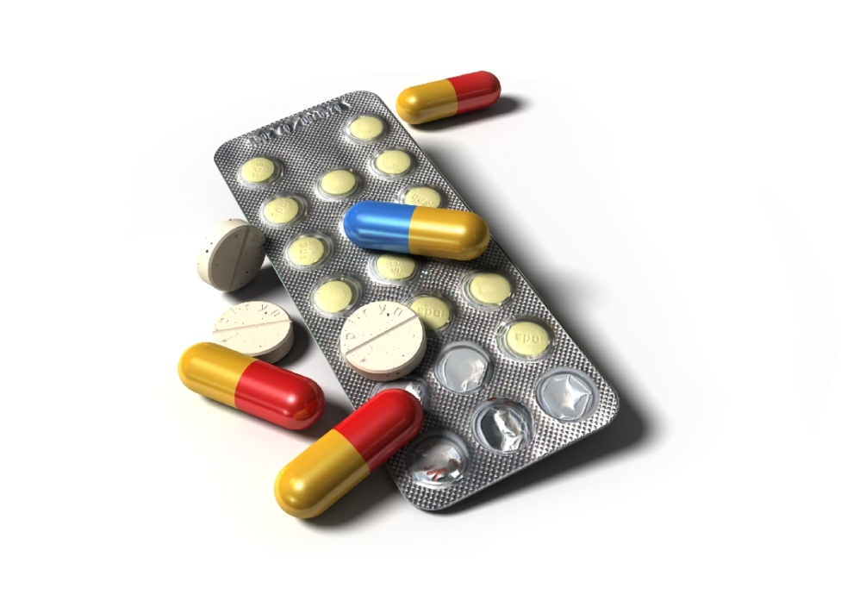
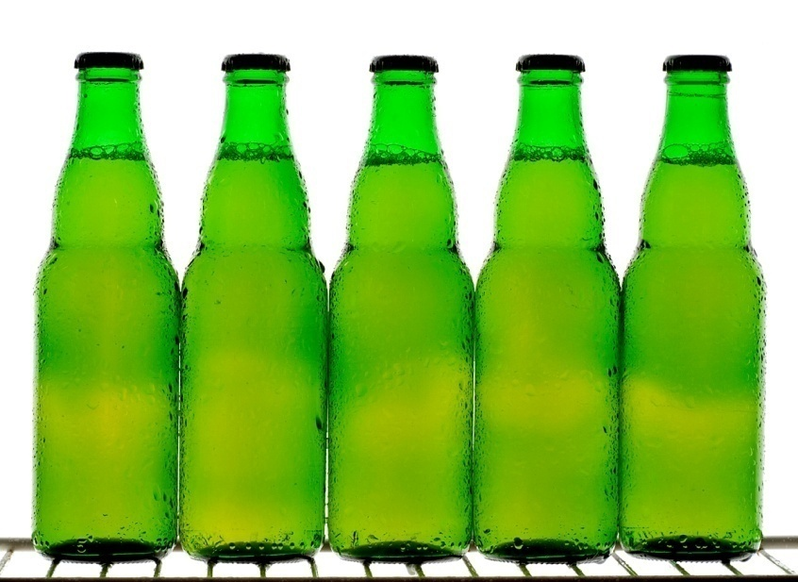
Drugs and alcohol

Slide 31
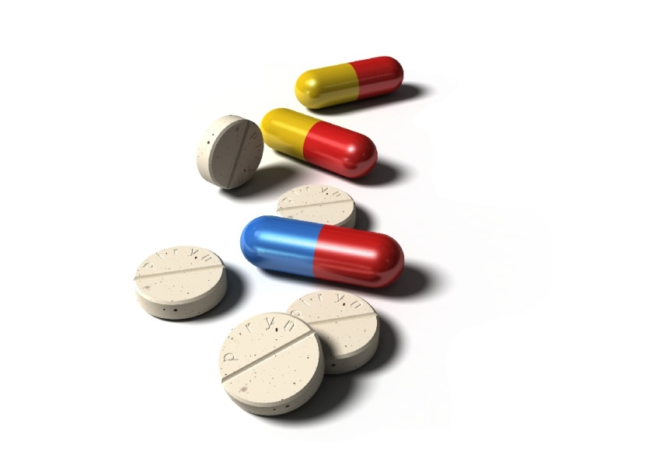
Drugs
Dangers of drugs
Alcohol
Cannabis
Cocaine and heroin
Tobacco
Alcohol and tobacco are legal drugs.
Cannabis, cocaine and heroine are illegal.
People can become addicted to a drug.
They feel dependent on it.
Drug addiction can have long term affects.
They can affect the brain and liver.
The liver is damaged as its job is destroying harmful chemicals within the body.
Legal drugs can be misused and become a danger.
A drug is something that changes the chemical processes in the body.
Recreational drugs are taken for pleasurable reasons.

Slide 32
Trialling drugs
1. Is it safe?
The drug is tested in a lab to see if it is toxic.
2. Is it safe for humans?
The drug is given the volunteers. They are given different doses to determine the maximum dose. Any side effects are recorded.
3. Does it work?
The drug is tested on the ill people who the drug was made for. If it makes them feel better it is sold commercially.
This process can take years and may not be successful
Even if a drug gets through the stages, it is 5 years before it is sold in chemists
When people use it, it may not be the miracle cure
E.g.
Thalidomide.
This was originally developed as a sleeping pill.
It was never tested on pregnant women.
It is now being used to treat leprosy.
But no pregnant women is allowed it.

Slide 33
Illegal drugs
Cocaine and heroine
They come from opium poppies which are grown in Afghanistan and Columbia.
They make people feel happy and relaxed.
Heroine and cocaine are dangerous and known as hard drugs.
Cocaine is addictive and you can get addicted after taking it once.
Cannabis
Drug made from dried leave.
It can be smoked like tobacco and causes bronchitis and lung cancer.
It makes you feel relaxed and happy.
People who suffer from multiple sclerosis say it makes them feel better.
It is likely to cause the illness schizophrenia.
Hard drugs
Opiates are drugs made from opium.
Diamorphine is an opiate and is used as pain relief in hospitals.
this in used under control and safely.
Heroine and cocaine are dangerous as people get addicted.
An addict can use a syringe to inject directly into a vein, as it gets to the
brain faster.
This adds dangers.
If several people use the same syringe , they can transmit diseases such as HIV/AIDS.
Drugs can take over a persons life.
If they stop, they develop withdrawal symptoms.
They cannot sleep, their eyes water constantly, they yawn, sweat and feel sick.

Slide 34
Alcohol
Is commonly used drug.
It can be misused.
Alcohol affects the nervous system. It causes:
Reactions to slow down
Loss of self control
Unconsciousness, coma and even death, when a lot is drunk
Alcohol damages the brain and liver
Brain cells are affected quickly
The cells shrink
People can get permanent brain damage
The liver gets damaged because its job is to break down alcohol.
Its changes it to harmless substances.
Too much can kill the livers cells.
People drink to relax and enjoy themselves.
If to much is drunk they get aggressive and violent
Alcohol dependency
People can become dependent on alcohol
They can’t manage without out
They spend so much they can't support their families or themselves.
They can lose jobs and families

Slide 35
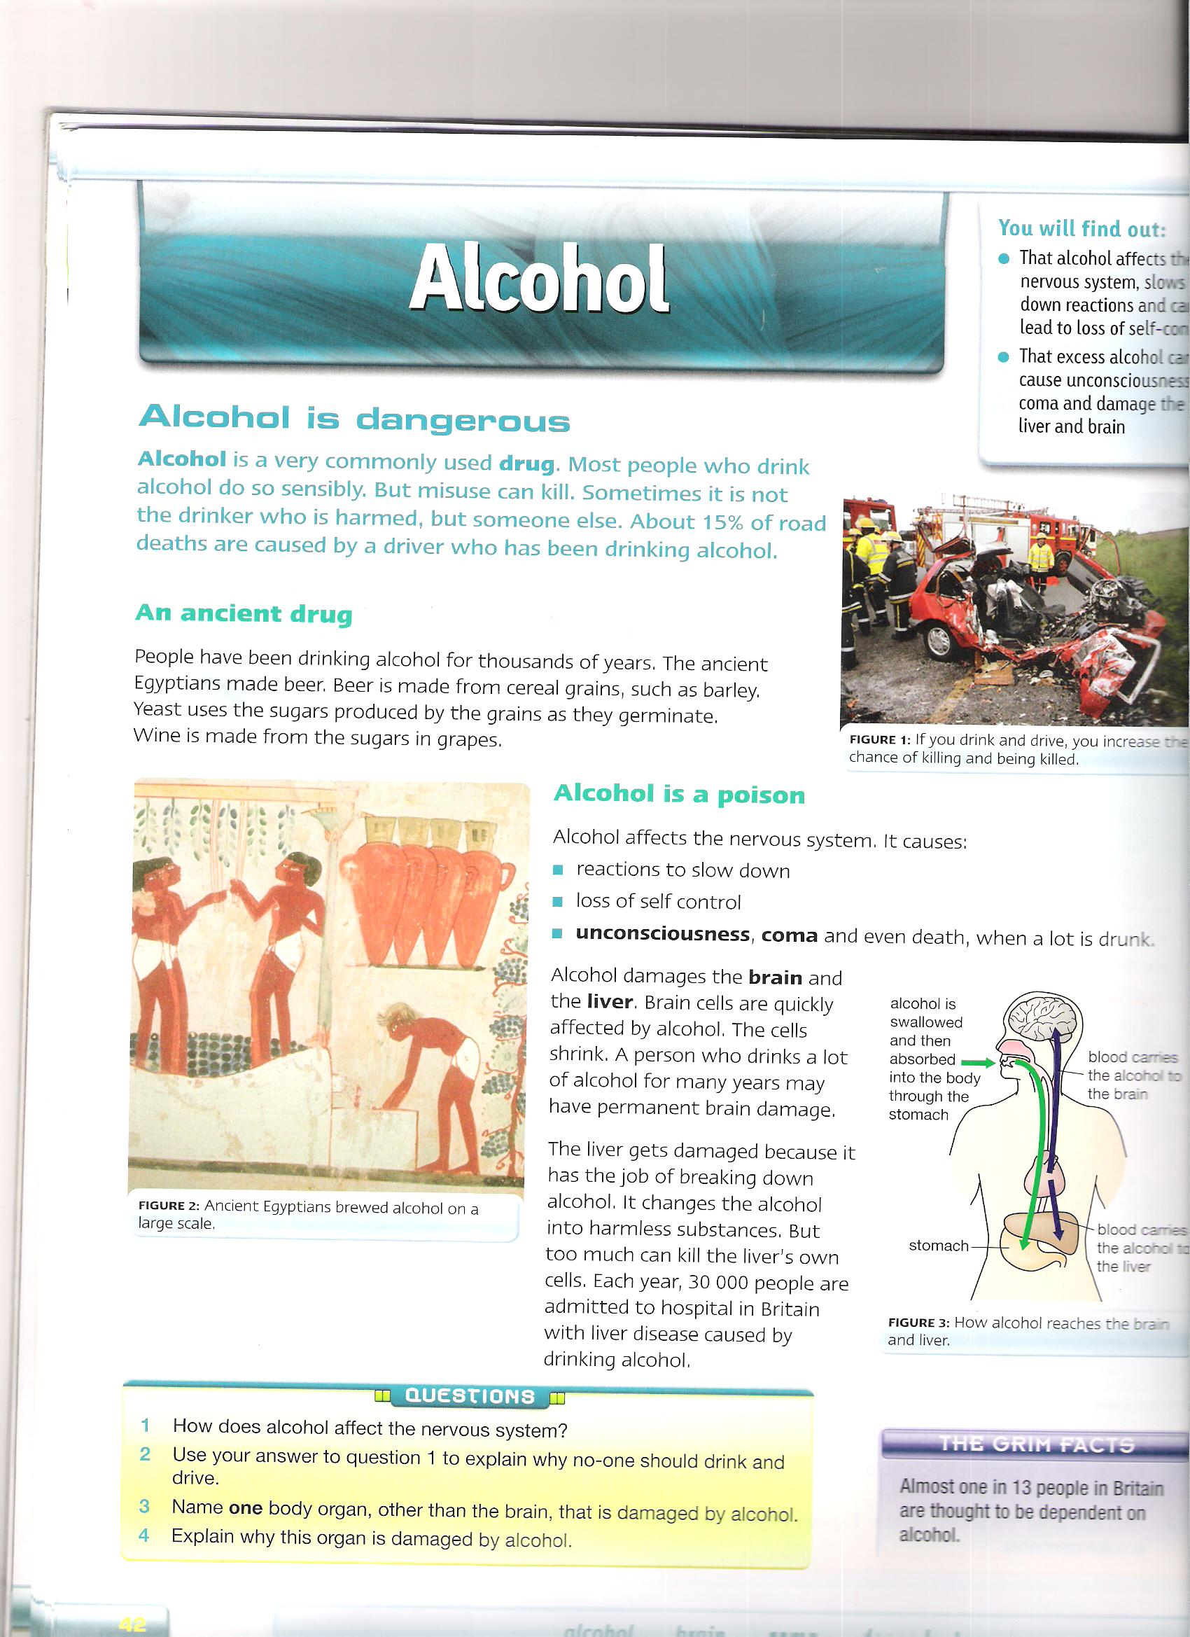
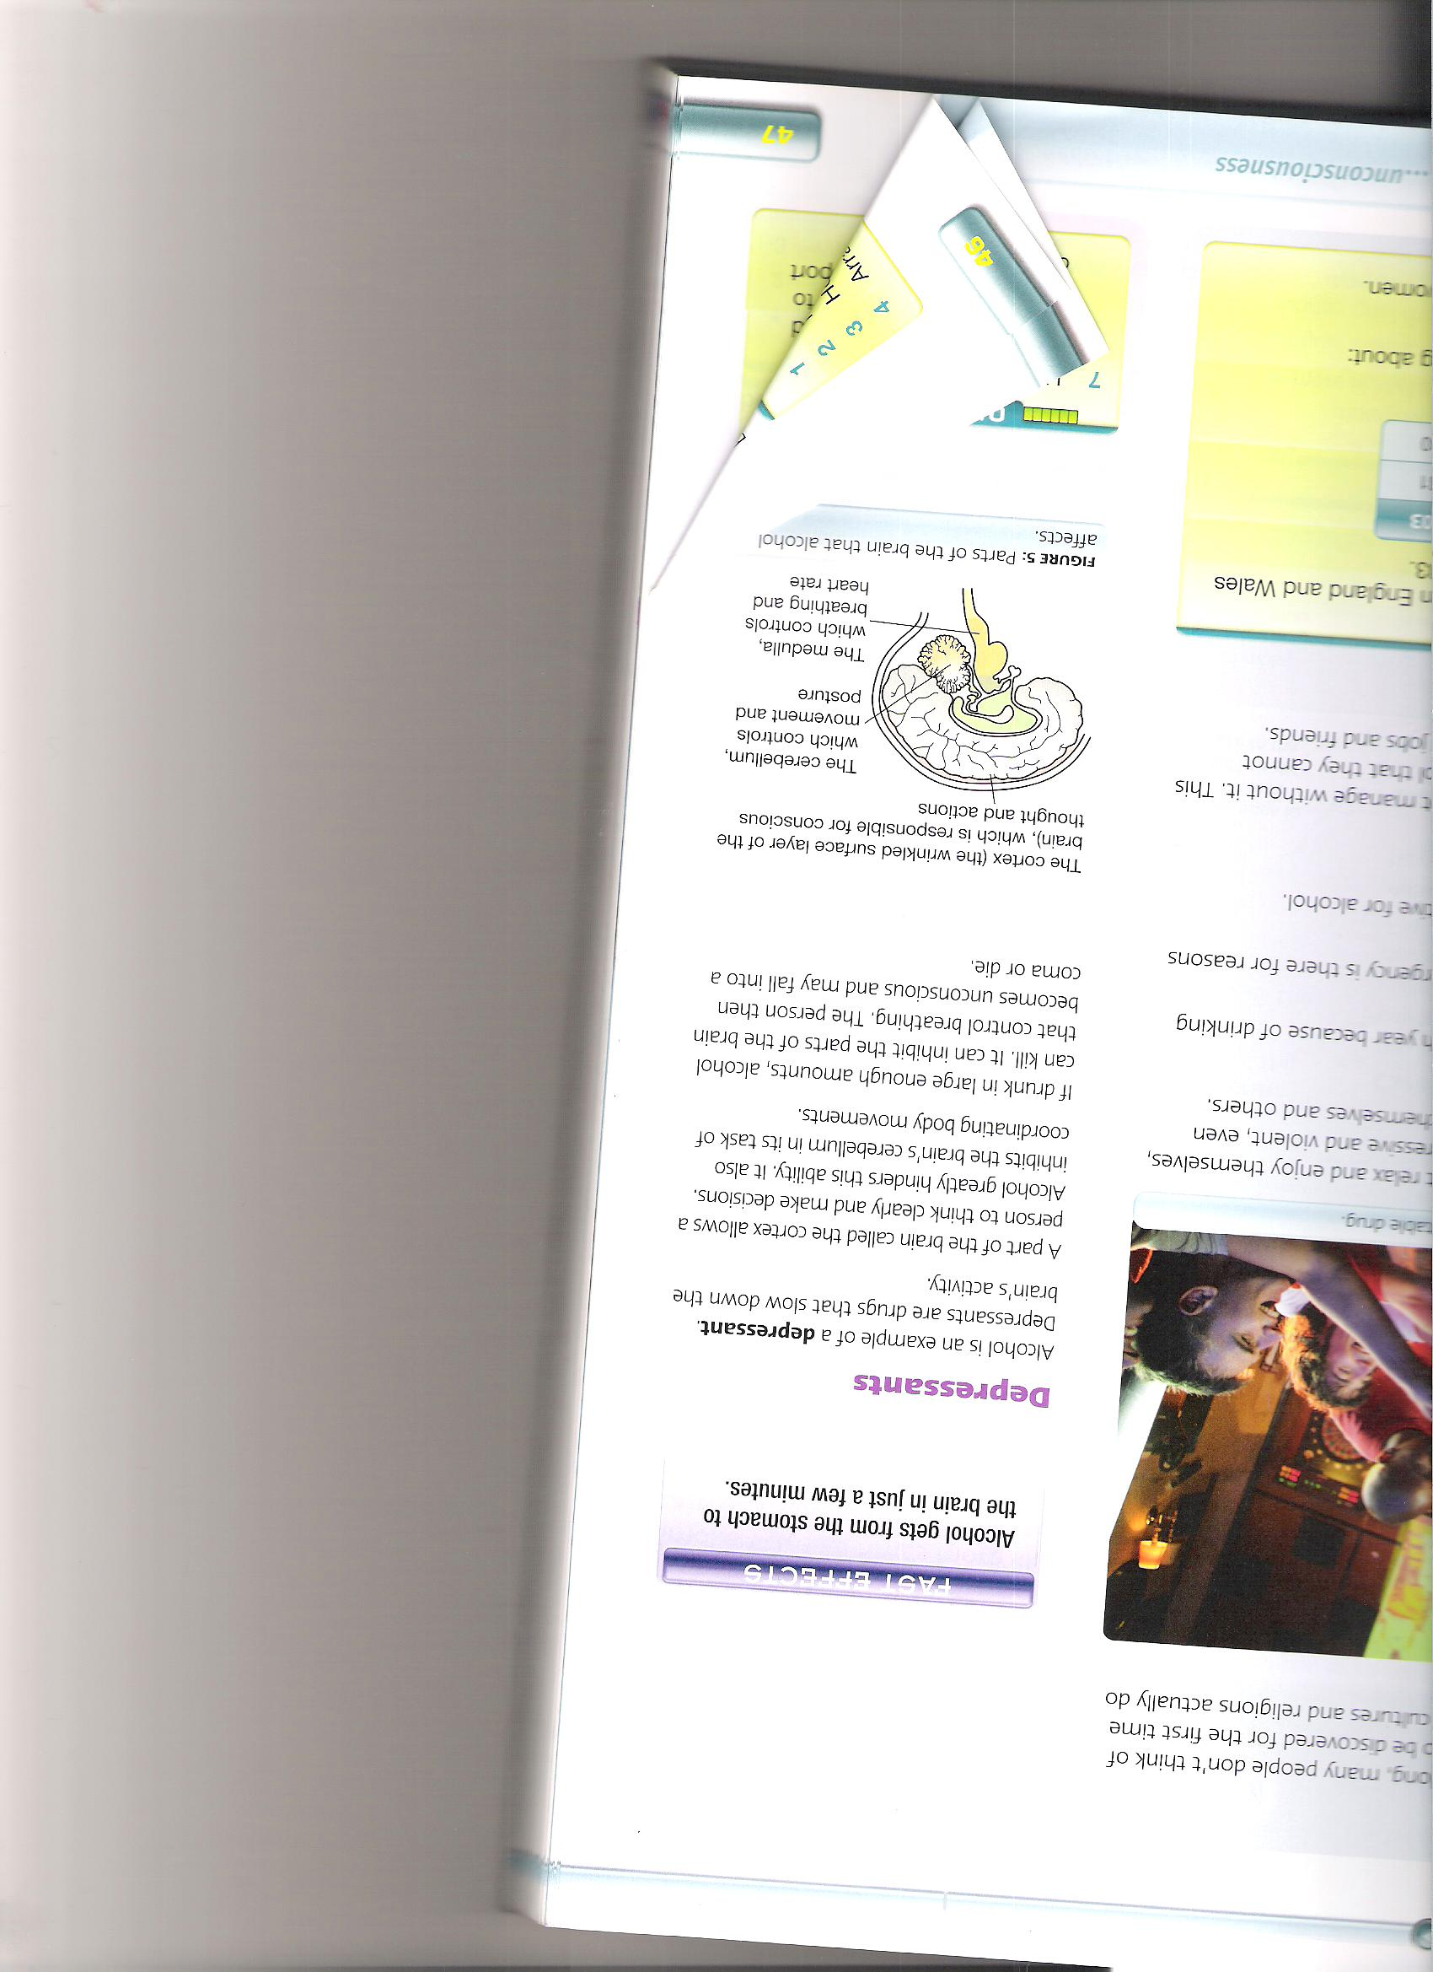
Alcohol is swallowed and then absorbed into the body through the stomach
The cortex(the wrinkled surface layer of the brain) which is responsible for conscious thought and actions
Blood carries alcohol the brain
The cerebellum which controls movement and posture
Blood carries the alcohol to the liver
The medulla which controls breathing and heart rate
stomach
Depressants
Alcohol is a depressant.
These are drugs that slow down brain activity
A part of the brain called the cortex allows a person to think clearly and make decisions.
Alcohol affects this ability
It also affects the cerebellum, which helps with coordination.
If to much is drunk, it can kill and cause a person to fall into a come or die due to the inhibit of breathing.

Slide 36
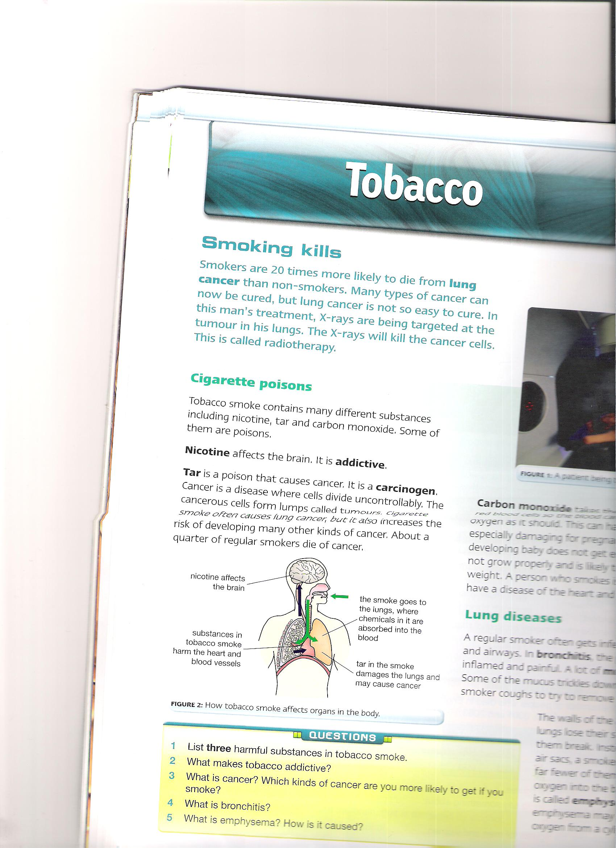
Tobacco
Lung diseases
A smoker get lung infections.
In the bronchitis, the smokers bronchi inflames.
Lots of mucus is produced.
This can cause excessive coughing.
The air sacs lose stretchiness.
It is difficult to get oxygen into the blood.
This is called emphysema.
Someone with this condition may have to breathe oxygen from a cylinder.
Cigarette poisons
Tobacco contains many different substances including nicotine, tar and carbon monoxide.
Nicotine- affects the brain. It is addictive.
Tar – is a poison that causes cancer. Its a carcinogen.
Cigarette smoke often causes lung cancer, but can risk development of other cancers.
Carbon monoxide- takes the place of oxygen in red blood cells, so the blood carries less oxygen. This can harm body cells.
In pregnant women this can be dangerous as the baby will get less oxygen, it may not grow properly and have a low birth weight. A person who smokes is likely to have heart disease.

Slide 37
Pathogens
Microorganisms and disease
Some bacteria and viruses can cause disease.
A microorganism that causes disease is called a pathogen.
If bacteria can get into the body, it reproduces rapidly.
They produce toxins that make you feel ill.
They are carried in the blood.
A virus can get into a cell and reproduce there.
When to much is produced they can burst out of the cell and destroy it.
Microorganisms
These are living things that we cannot see.
They include bacteria and viruses
Humans are visible organisms, which are made up of tiny cells.
Each bacterium is made up of one cell.
Their cells are smaller than ours.
You can’t see bacteria clearly.
Viruses are even smaller.
There are some viruses that can get into bacteria, so bacteria can also get ill.

Slide 38
Body defences
Epidemic and pandemics
Sometimes people get a flu.
When lots of people have an infectious disease at the same time, this is an epidemic.
When an epidemic spreads worldwide, its known as a pandemic.
White blood cells
These are our defence forces.
They attack and destroy pathogens in the body.
They are part of our immune system.
Some white blood cells surround bacteria and take them into its cytoplasm.
They kill them and make antibodies, that destroy bacteria.
Or antitoxins, that neutralise the poisons that the bacteria makes.

Slide 39
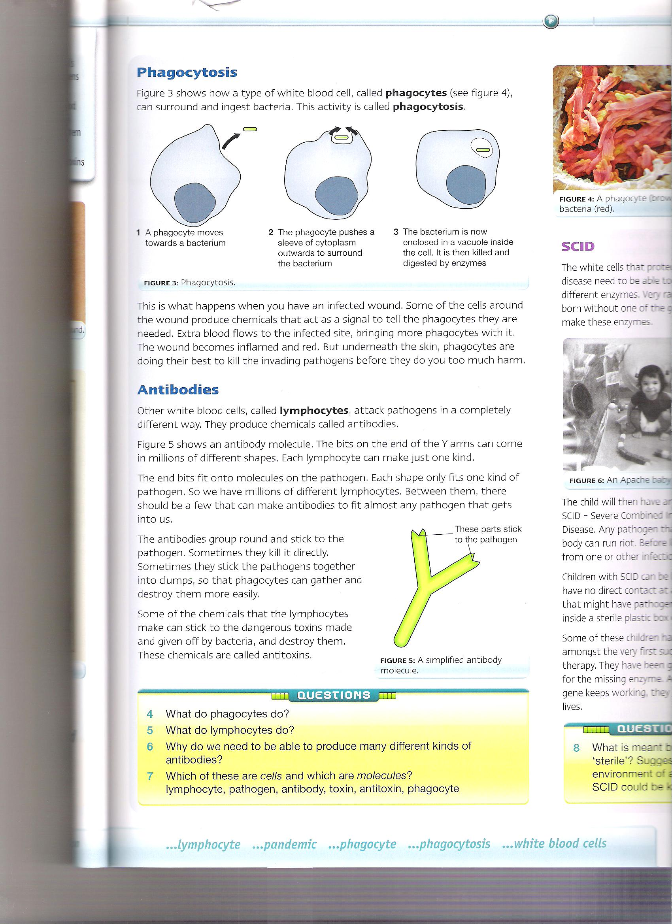
Phagocytosis
Antibodies
Other white blood cells, called lymphocytes, that attack pathogens in a different way.
They produce chemicals called antibodies.
This is an anti body molecule.
The end bits fit onto molecules of the pathogen.
Each shape fits one kind of pathogen.
So we have millions of lymphocytes.
The antibodies group around and stick to the pathogen.
They can kill it directly or stick to it in clumps, so phagocytes can gather and destroy them more easily.
Some of the chemical that the lymphocytes make can stick to the dangerous toxins made and given off by bacteria, can destroy them
These chemicals are called antitoxins.
This shows how a white blood cell, called phagocytes.
They surround and ingest bacteria. This activity is called phagocytosis.
This is what happens when you have an infected wound.
Some of the cells around the wound produce chemicals that tells the phagocytes they’re needed.
Extra blood flows to the infected site, bringing more phagocytes with it.
The would becomes inflamed and red.
But under the skin, they are dong their best to kill the pathogens.

Slide 40
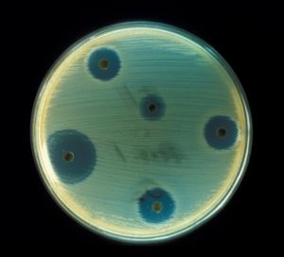
Drugs against disease
Sources of antibiotics
Penicillin is made from a fungus.
The drug companies are always on the look out for new antibiotics.
Nowadays, most antibiotics are made chemically.
This is better then extracting them from fungi or other organisms because you know hat you're getting.
If you take it from fungus, you don’t know the strength of it.
Making it chemically means you know its pure
Painkillers
A drug used to get rid of pain.
You can buy these, e.g. Aspirin, paracetamol and ibuprofen.
They reduce symptoms of whatever is wrong with you.
Antibiotics
These are drugs that kill bacteria inside your body.
They don’t kill viruses.
Antibiotics include penicillin and streptomycin.
We different ones as they don't all work equally well against all kind of bacteria.
Antiviral
Viruses are more difficult to kill.
If they go inside a cell they are impossible to kill it without killing the cell.
Antivirals are used to kill viruses.

Slide 41
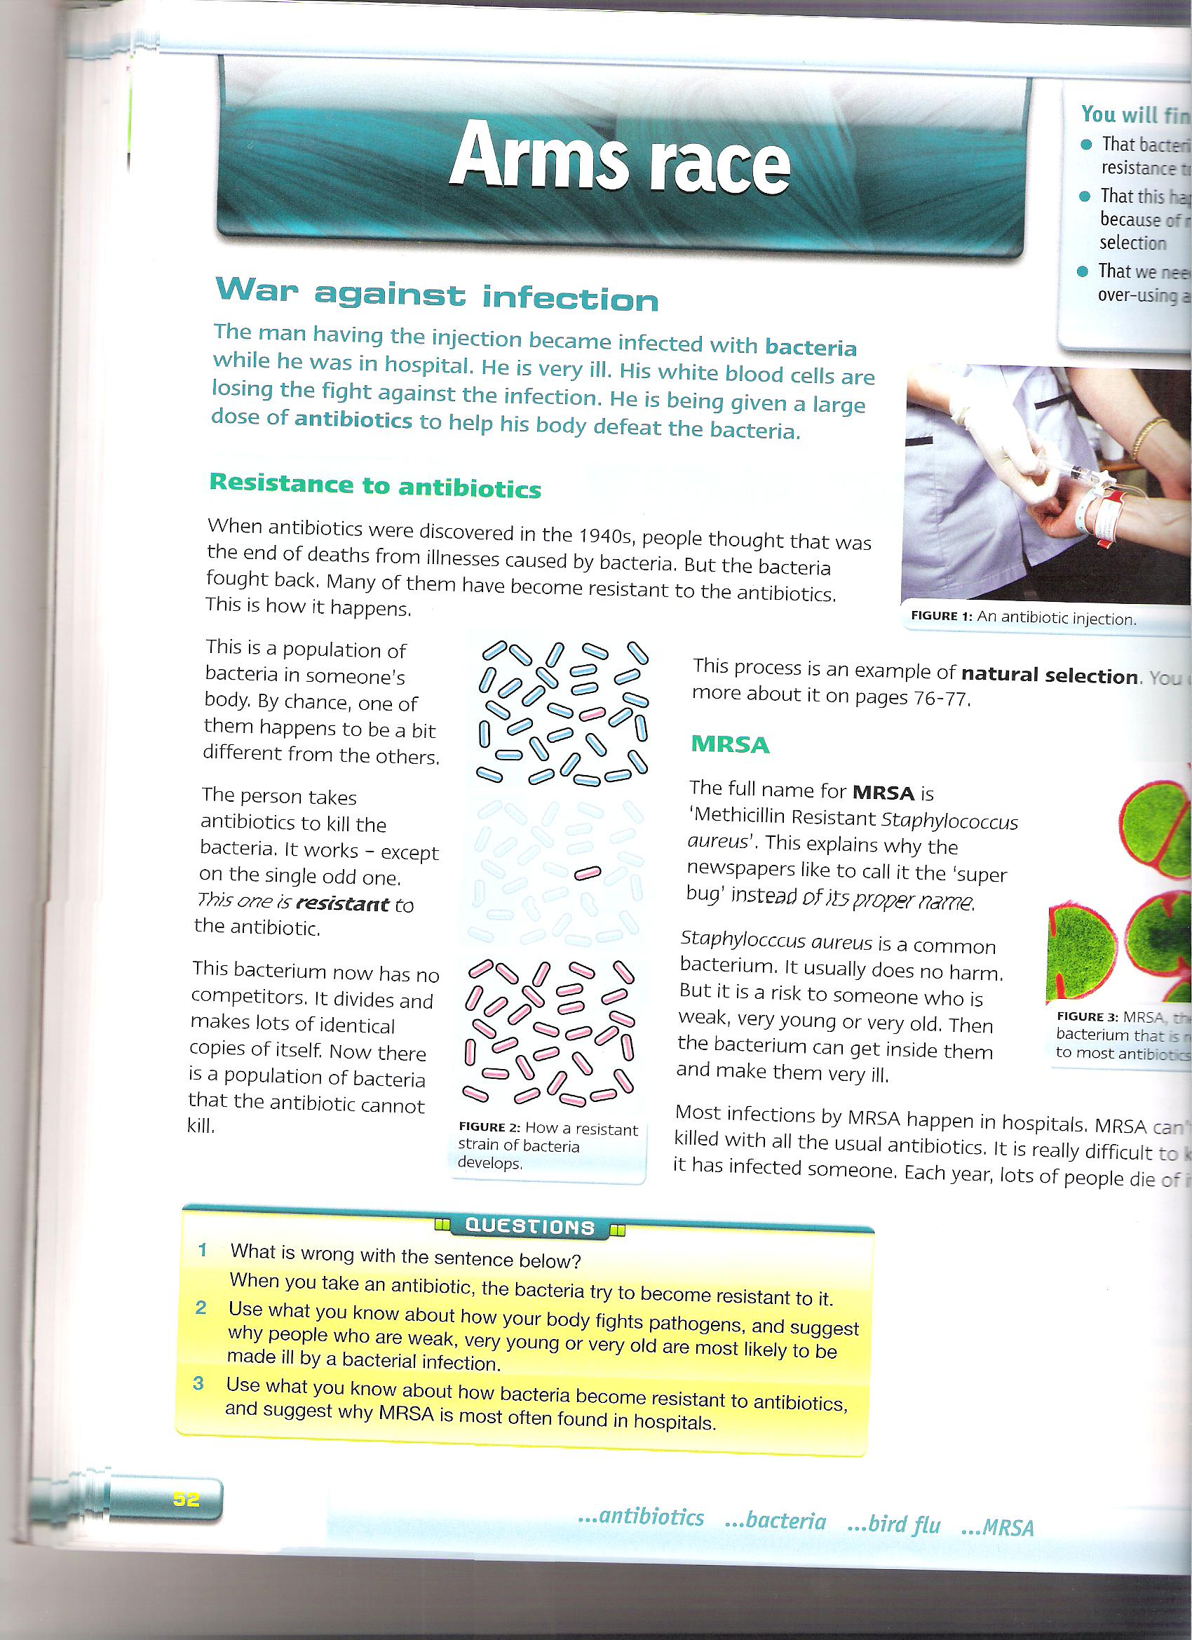
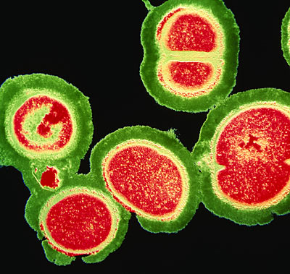
Resistance to antibiotics
MRSA
Methicillin Resistant Staphylococcus aureus.
Staphylococcus aureus is a common bacterium.
It doesn’t normally harm someone except a weak, very young or very old person.
MRSA infection is in hospitals.
It can’t be killed with usual antibiotics.
It is difficult to kill once someone is infected.
Resistance to antibiotics
This is a population of bacteria in a person’s body. One of them is different.
The person takes antibiotics to kill the bacteria. It works but of them is resistant to the antibiotic.
The bacterium has now divided and made copies of itself. There is now a population of bacteria that the antibiotic cannot kill.

Slide 42
Vaccination
They can even make antibodies.
These stick to bits of the surface of the virus or bacteria and attack it. They are called antigens.
The white blood cells make different antibodies for each antigen.
If you get infected by the real, live pathogen, your white blood cells are ready to make the right sort of antibodies.
They will then destroy the pathogen before it makes you ill.
Immunisation
Means making immune
You can be immunised against mumps, measles and rubella, polio and diphtheria
You have a small amount of dead or inactive viruses or bacteria jabbed into you blood.
Your white blood cells don’t know they’re harmless and attack them like pathogens.
The MMR jab
This is given to children to protect them against Measles, Mumps and Rubella.
These disease are caused by viruses.
In 1988 it was told MMR jab caused autism.
However scientist had no evidence that it was.

