Slide 1
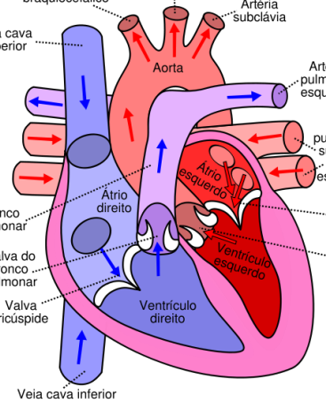
Structure of the Heart

Slide 2
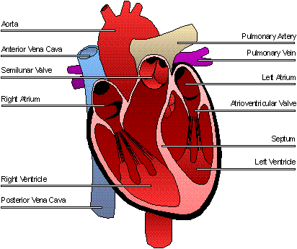
Click on a part of the heart or press Esc to exit.

Slide 3
Aorta
The Aorta is the main artery in the human body.
It goes from the left ventricle to the abdomen.
It pumps oxygenated around the body.

Slide 4
Pulmonary Veins
The pulmonary veins carry oxygenated blood from the lungs into the left atrium.
This is one of the few veins that carries oxygenated blood.

Slide 5
Pulmonary Artery
Carries deoxygenated blood to the lungs.
It is one of the only arteries that carries deoxygenated blood.

Slide 6
Ventricles
The right ventricle pumps deoxygenated blood to the lungs.
The left ventricle pumps oxygenated blood to the body through the aorta.
The left ventricle has the thickest wall because it has to pump blood all the way around the body.

Slide 7
Atria
The atria are the upper chambers of the heart.
Blood enters the right atrium through the vena cava.
Blood enters the

Slide 8
Vena Cava
There are two vena cavas: the inferior and the superior.
The inferior Vena Cava is a vein that carries deoxygenated blood from the lower body.
The superior Vena Cava carries deoxygenated blood from the upper body.

Slide 9
Semilunar valves
The semilunar valves are located at the base of the aorta and the pulmonary artery.
They prevent backflow of blood from these arteries into the ventricles.

Slide 10
Atrioventricular valves
There are two of these valves: The tricuspid and bicuspid valves.
The tricuspid valve is on the right and the bicuspid valve is on the left.
These valves prevent backflow of blood into the atria.
The valves are held closed by tendinous cords. These do not stretch but are attached to papillary muscles that do.

