Slide 1
Unit 2: The variety of living organisms
Chapters:
7 – Variation
8 – DNA and meiosis
9 – Genetic diversity
10 – The variety of life
11 – The cell cycle
12 – Cellular organisation
13 – Exchange and transport
14 – Classification
15 – Evidence for relationships between organisms
16 – Adaptation and selection
17 – Biodiversity
Length: 1 hour and 45 minutes
Total marks: 85
Percentage of AS/A2:
46.7%/23.3%
Unit introduction:
Although a species may be defined in terms of similarity, there is frequently considerable intraspecific variation and this is influenced by genetic and environmental factors. DNA is an information carrying molecule, and similarities and differences in the sequence of bases in DNA result in genetic diversity.
The variety of life is extensive and is reflected in similarities and differences in its biochemical basis and cellular organisation. Factors such as size and metabolic rate affect the requirements of organisms and this gives rise to adaptations such as specialised exchange surfaces and mass transport systems.
Classification is a means of organising the variety of life based on relationships between organisms and is built round the concept of a species. Originally, classification systems were based on observable features but more recent approaches draw on a wider range of evidence to clarify relationships between organisms. Variation that exists at the interspecific level contributes to the biodiversity of communities and ecosystems.

Slide 2
Unit 2: Chapter 7: Variation
7.1 Investigating variation:
How is variation measured?
What is sampling and why is it used?
What are the causes of variation?
Key words:
interspecific variation; intraspecific variation: sampling bias; chance; random sampling; sample size; mutations; meiosis; fusion; gametes; genetic; environmental
What is interspecific variation?
What is intraspecific variation?
How can a population be sampled?
Why might samples not be representative of a population?
How can we increase the reliability of a sample?
What is meant by the term genetic variation?
What is meant by the term environmental variation?

Slide 3
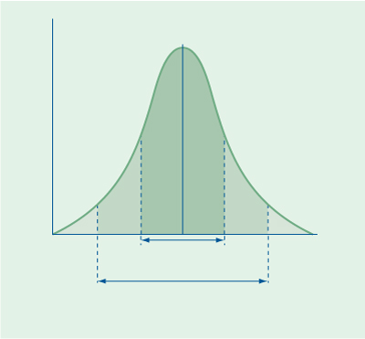
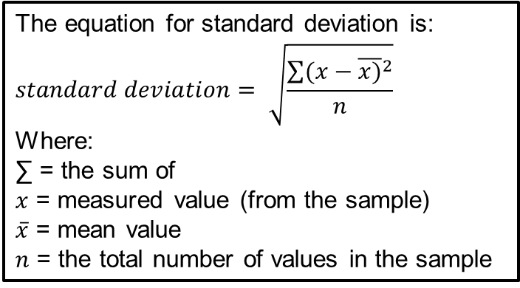
Unit 2: Chapter 7: Variation
7.2 Types of variation:
What are the types of variation?
What is the mean of a normal distribution?
What is standard deviation and how is it calculated?
Key words:
normal distribution curve; mean; standard deviation;
What is genetic variation? Cont.
Label the graph of
normal distribution
What is environmental variation? Cont.
The equation for standard deviation is:
$$standard deviation= \sqrt{\frac{\sum{{(x−\overline{x)}}^{2}}}{n}}$$
Where:
∑ = the sum of
$x$ = measured value (from the sample)
$\overline{x}$ = mean value
$n$ = the total number of values in the sample
Practice the using the equation with the values 0, 1, 2, 3, 4 and 5:

Slide 4
Unit 2: Chapter 7: Variation
Exam questions
Explain what is meant by genetic diversity.
(1 mark)
Apart from genetic factors what other type of factor causes variation within a species?
(1 mark)
The spotted owl is a bird. Numbers of spotted owls have decreased over the past 50 years. Explain how this decrease may affect genetic diversity.
(2 marks)

Slide 5

Unit 2: Chapter 7: Variation
Exam questions
The crimson topaz and the fiery topaz are hummingbirds.
Biologists investigated whether the crimson topaz and the fiery topaz are different species of hummingbird, or different forms of the same species.
They caught large numbers of each type of hummingbird. For each bird they
  recorded its sex
  recorded its mass
  recorded the colour of its throat feathers
  took a sample of a blood protein.
The table shows some of their results.
Explain how the standard deviation helps in the interpretation of these data.
(2 marks)

Slide 6
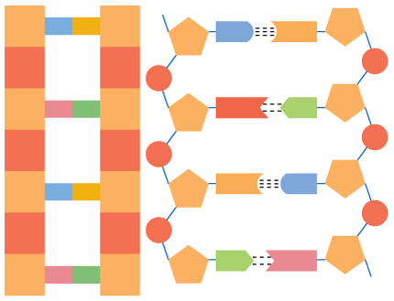
Unit 2: Chapter 8: DNA and meiosis
8.1 Structure of DNA:
What are the component of DNA?
How are these components arranged within the DNA double helix?
What is the function of DNA?
Key words: cytosine; thymine; adenine; guanine; phosphate; deoxyribose sugar; condensation reaction; mononucleotide; dinucleotide; polynucleotide; complementary; double helix;
Label the diagram of DNA to show the components of DNA and how they are arranged:
Explain why pairing of bases:
Explain why DNA forms a double helix:
Explain the function of DNA:

Slide 7
Unit 2: Chapter 8: DNA and meiosis
8.2 The triplet code:
What is a gene?
How do genes code for polypeptides?
Key words:
gene; triplicate code; polypeptide; amino acid
What is a gene?
What the triplicate code?

Slide 8
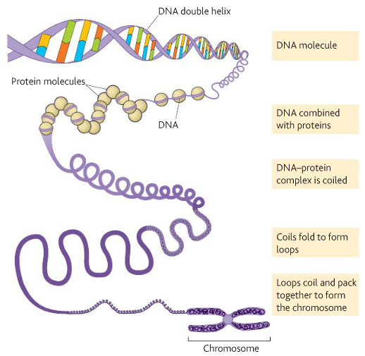
Unit 2: Chapter 8: DNA and meiosis
8.3 DNA and chromosomes:
How does DNA in prokaryotic organisms differ from the DNA in eukaryotic organisms?
What is a chromosome?
How are genes arranged on a DNA molecule?
What are homologous chromosomes?
What is an allele?
Key words: prokaryotic cell; eukaryotic cell; chromosomes; chromatid; centromere; histone; homologous pairs; allele
How does DNA in prokaryotic organisms differ from the DNA in eukaryotic organisms?
Fill in the boxes to show how DNA in packed into a chromosome:
What is a homologous chromosome?
What is an allele?

Slide 9
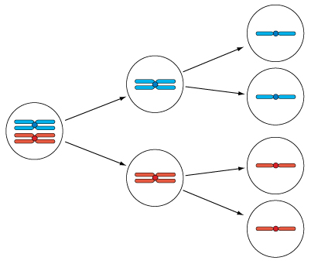
Unit 2: Chapter 8: DNA and meiosis
8.4 Meiosis:
Why is meiosis necessary?
What happens during meiosis?
How does meiosis create genetic variation?
Key words:
mitosis; meiosis; gametes; diploid; haploid; crossing over; gene; locus; allele; interdependent segregation; recombination;
What is meiosis? Use the diagram in your explanation.
Explain interdependent segregation and how this leads to genetic variety:
Explain genetic recombination by crossing over:

Slide 10
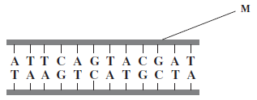
Unit 2: Chapter 8: DNA and meiosis
Exam questions
The diagram shows part of a DNA molecule.
Name the two components of the part of the DNA molecule labelled M.
1
2
(2 marks)
What is the maximum number of amino acids for which this piece of DNA could code?
(1 mark)
Scientists calculated the percentage of different bases in the DNA from a species of bacterium. They found that 14% of the bases were guanine.
What percentage of the bases in this species of bacterium was cytosine?
Answer ....................................... (1 mark)
What percentage of the bases in this species of bacterium was adenine?
Answer ....................................... (1 mark)
The scientists found that, in a second species of bacterium, 29% of the bases were guanine. Explain the difference in the percentage of guanine bases in the two species of bacterium.
(2 marks)

Slide 11
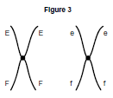

Unit 2: Chapter 8: DNA and meiosis
Exam questions
Figure 3 shows a pair of chromosomes at the start of meiosis. The letters represent alleles.
What is an allele?
(1 mark)
Explain the appearance of one of the chromosomes in Figure 3.
(2 marks)
The cell containing this pair of chromosomes divided by meiosis. Figure 4 shows the distribution of chromosomes from this pair in four of the gametes produced.
Some of the gametes formed during meiosis have new combinations of alleles.
Explain how the gametes with the combinations of alleles Ef and eF have been produced.
(2 marks)

Slide 12
Unit 2: Chapter 8: DNA and meiosis
Exam questions
Only a few gametes have the new combination of alleles Ef and eF. Most gametes have the combination of alleles EF and ef. Suggest why only a few gametes have the new combination of alleles, Ef and eF.
(1 mark)
Figure 5 shows a cell with six chromosomes.
This cell produces gametes by meiosis. Draw a diagram to show the chromosomes in one of the gametes.
(2 marks)
How many different types of gametes could be produced from this cell as a result of
different combinations of maternal and paternal chromosomes?
(1 mark)

Slide 13
Unit 2: Chapter 9: Genetic diversity
9.1 Genetic diversity and the influences on it:
Why are organisms difference from one another?
What factors influence genetic diversity?
Key words: species; alleles; genetic diversity; artificial selection; founder effect; genetic bottleneck; selective breeding; artificial insemination;
What is genetic diversity?
What is the founder effect?
What is selective breeding?
Is it ethical?
What is a genetic bottle neck and what effect does it have?

Slide 14
Unit 2: Chapter 9: Genetic diversity
Exam questions
A species of seal shows genetic diversity. Explain what is meant by genetic
diversity.
(1 mark)
In the late 18th century, the population of northern elephant seals was estimated to be about 150 000. These seals lived in different colonies in different places. The seals were then hunted. By 1910, the total population had fallen to under 100. All these seals lived in a single colony on one island. Hunting then stopped. Numbers increased and there are now approximately 150 000 seals living in many different colonies.
Use this information to explain
what is meant by a genetic bottleneck
(2 marks)
how you would expect the founder effect to have influenced the genetic diversity of northern elephant seals after 1910.
(2 marks)

Slide 15
Unit 2: Chapter 10: The variety of life
10.1 Haemoglobin:
What are haemoglobins and what is their role?
How to haemoglobins from different organisms differ and why?
What is loading and unloading of oxygen?
Key words:
Describe the structure of haemoglobin:
Primary structure:
Secondary structure:
Tertiary structure:
Quaternary structure:
Explain the role of haemoglobin:
Some haemoglobin has a high affinity for oxygen and others a low affinity. What are the theories for having different haemoglobins?
What is oxygen loading and unloading?

Slide 16
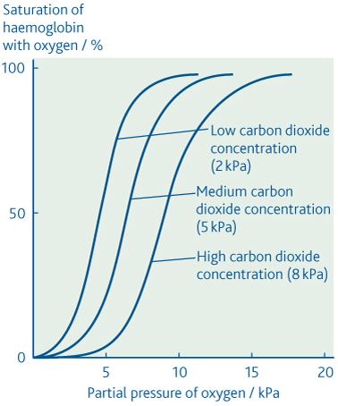
Unit 2: Chapter 10: The variety of life
10.2 Oxygen dissociation curves:
What is an oxygen dissociation curve?
What is the effect of carbon dioxide concentration on the curve and why?
How do the properties of the haemoglobin in different organisms relate to the environment and way of life of the organisms concerned?
Key words:
What are the main features of an oxygen dissociation curve?
Explain the Bohr effect, using the graph to help:
How does the loading and unloading of oxygen work?

Slide 17
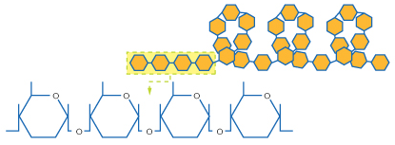
Unit 2: Chapter 10: The variety of life
10.3 Starch, glycogen and cellulose:
How are α-glucose monomers arranged to form the polymers of starch and glycogen?
How are β-glucose monomers arranged to form the polymer cellulose?
How do the molecular structure of starch, glycogen and cellulose relate to their function?
Key words:
starch; condensation reaction; osmosis; glycogen; cellulose; hydrogen bonds
Label the diagram to showing the structure of starch
List some of the properties of starch:
Draw a diagram to show the structure of cellulose:
Explain how it’s structure relates to it’s function:
What us glycogen?

Slide 18
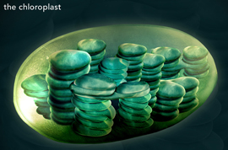
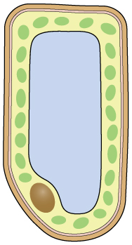
Unit 2: Chapter 10: The variety of life
10.4 Plant cell structure:
What is the structure of leaf palisade cells?
What is the structure of a chloroplast and how is it related to its function?
What is the plant cell wall composed of and what is its function?
How do plant cells differ from animal cells?
Key words:
palisade; eukaryotic cell; chloroplast; grana; thylakoids; chlorophyll; stroma; lamella; xylem; root hair cell;
Label the structures in a leaf palisade cell:
Label the structures in a
chloroplast and state their
function:
What is the plant cell wall composed of and what is its function?

Slide 19
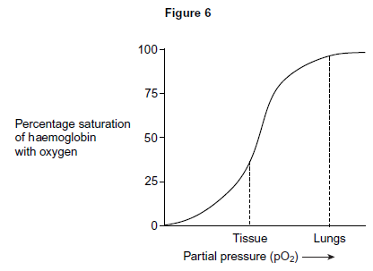
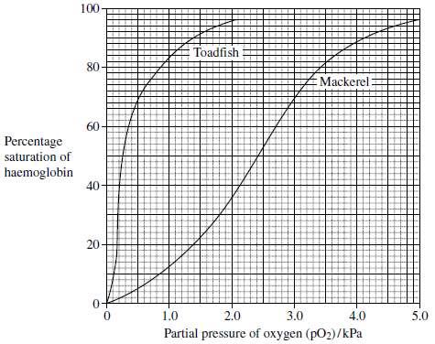
Unit 2: Chapter 10: The variety of life
Exam questions
Figure 6 shows the oxygen dissociation curve for human haemoglobin.
Use Figure 6 to describe how haemoglobin loads and unloads oxygen in the body.
(3 marks)
The graph shows oxygen dissociation curves for toadfish haemoglobin and for mackerel haemoglobin.
Explain how the shape of the curve for toadfish haemoglobin is related to where the
toadfish is normally found.
(2 marks)

Slide 20
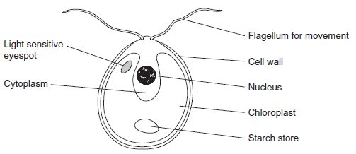
Unit 2: Chapter 10: The variety of life
Exam questions
The cell walls of potato cells contain cellulose. Cellulose and starch are both carbohydrates. Describe two ways in which molecules of cellulose are similar to molecules of starch.
(2 marks)
The diagram shows an organism called Chlamydomonas.
Name two structures shown in the diagram that are present in plant cells but are not present in animal cells.
1
2
(2 marks)
Give one feature of starch and explain how this feature enables it to act as a storage
substance.
Feature:
Explanation:
(2 marks)

Slide 21
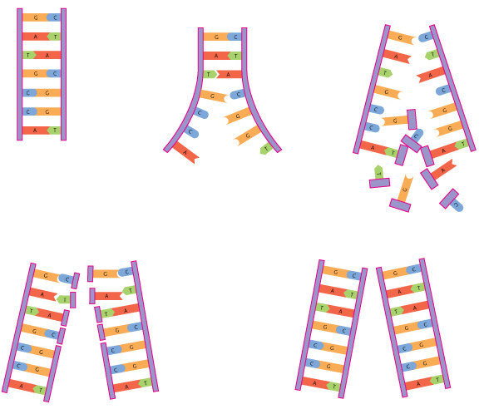
Unit 2: Chapter 11: The cell cycle
11.1 Replication of DNA:
What happens during DNA replication?
How is a new polynucleotide strand formed?
Why is the process of DNA replication called semi-conservation?
Key words:
nuclear division; cell division; DNA helicase; DNA polymerase
Explain the semi conservative
model of DNA replication:

Slide 22
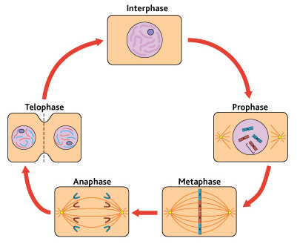
Unit 2: Chapter 11: The cell cycle
11.2 Mitosis:
What is mitosis?
When does DNA replication take place?
What is the importance of mitosis?
Key words:
mitosis; meiosis; prophase; metaphase; anaphase; telophase; growth; differentiation; repair
Describe the process that take place during the different stages of mitosis:
Explain the role of mitosis in growth:
repair:
differentiation:

Slide 23
Unit 2: Chapter 11: The cell cycle
11.3 The cell cycle:
What are the three stages of the cell cycle?
What happened during interphase?
How does cancer and its treatment relate to the cell cycle?
Key words:
interphase; nuclear division; cell division;
Describe the three stages of the cell cycle:
Interphase:
a)
b)
c)
Nuclear division
Cell division
How does cancer and its treatment relate to the cell cycle?

Slide 24
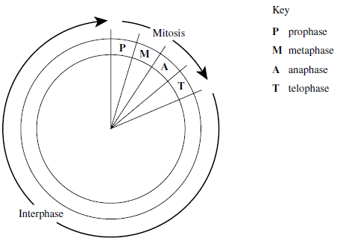
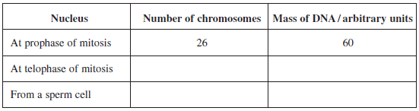
Unit 2: Chapter 11: The cell cycle
Exam questions
The diagram shows a cell cycle.
The table shows the number of chromosomes and the mass of DNA in different nuclei.
All the nuclei come from the same animal. Complete this table.
(4 marks)
If the DNA of the cell is damaged, a protein called p53 stops the cell cycle.
Mutation in the gene for p53 could cause cancer to develop. Explain how.
(3 marks)
Drugs are used to treat cancer. At what phase in the cell cycle would each of the
following drugs act?
A drug that prevents DNA replication
(1 mark)
A drug that prevents spindle fibres shortening
(1 mark)

Slide 25
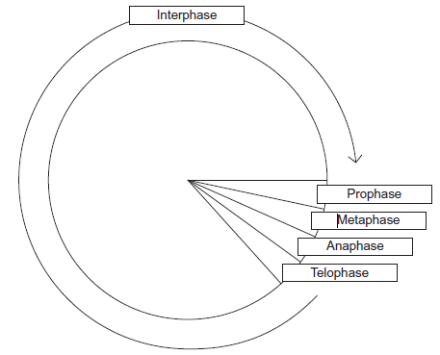
Unit 2: Chapter 11: The cell cycle
Exam questions
The diagram shows a cell cycle.
In prophase of mitosis, the chromosomes become visible. Describe what happens in
metaphase
(2 marks)
anaphase.
(2 marks)
Cells lining the human intestine complete the cell cycle in a short time. Explain the
advantage of these cells completing the cell cycle in a short time.
(1 mark)

Slide 26
Unit 2: Chapter 12: Cellular organisation
12.1 Cell differentiation and organisation:
What are the advantages of cellular differentiation?
How are cells arranged into tissues, organs and organ systems?
Key words:
cell differentiation; epithelia tissues; xylem; tissue; organs; digestive system; respiratory system; circulatory system;
What is cell differentiation?
How are cells arranged in organs? Give examples.
How are cells arranged in tissues? Give examples.
How are cells arranged in organ systems? Give examples.

Slide 27
Unit 2: Chapter 12: Cellular organisation
Exam questions
What is a tissue?
(1 mark)
A leaf is an organ. What is an organ?
(1 mark)

Slide 28
Unit 2: Chapter 13: Exchange and transport
13.1 Exchange between organisms and their environment:
How does the size of an organism and its structure relate to its surface area to volume ratio?
How do larger organisms increase their surface area to volume ratio?
How are surfaces specially adapted to facilitate exchange?
Key words:
diffusion; osmosis; surface area to volume ratio;
List examples of things that need to be interchanged between an organism and it’s environment:
How is surface area to volume ration calculated:
Compare a cube of 1cm³ to a cube of 6cm³
How are surfaces specially adapted to facilitate exchange? Give examples

Slide 29
Unit 2: Chapter 13: Exchange and transport
13.2 Gas exchange in single-celled organisms and insects:
How do single-celled organisms exchange gases?
How do terrestrial insects balance their need to exchange gases with the need to conserve water?
How do insects exchange gases?
Key words:
waterproof covering; diffusion gradient; ventilation; spiracle; trachea; tracheloes;
How do single-celled organisms exchange gases?
Describe gas exchange in insects, using diagrams as part of your answer.
How does insects prevent water loss?

Slide 30
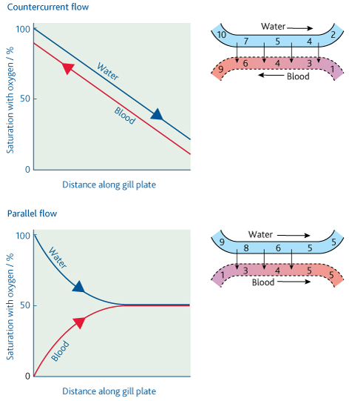
Unit 2: Chapter 13: Exchange and transport
13.3 Gas exchange in fish:
What is the structure of fish gills?
How is water passed along fish gills?
What is the difference between parallel flow and countercurrent flow?
How does countercurrent flow increase the rate of gas exchange?
Key words:
gill filaments; gill lamelle; countercurrent flow;
Describe parallel flow and countercurrent flow
Draw and label the arrangement of gills in a fish:

Slide 31
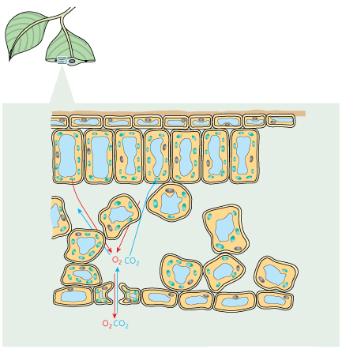
Unit 2: Chapter 13: Exchange and transport
13.4 Gas exchange in the leaf of a plant:
How do plants exchange gases?
What is the structure of a dicotyledonous plant leaf?
How is the lead adapted for efficient gas exchange?
Key words:
stomata; epidermis; mesophyll; air space
Label the structures that allow gas exchange to take place and describe their functions:
Describe the process of opening and closing the stomata:
What is the reason for the stomata opening and closing

Slide 32
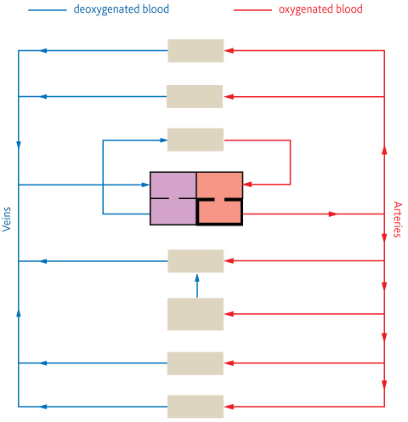
Unit 2: Chapter 13: Exchange and transport
13.5 Circulatory system of a mammal:
How do large organisms move substances around their bodies?
What are the features of the transport systems of large organisms?
How is blood circulated in mammals?
Key words:
diffusion; metabolism
Explain why large organisms need a complex transport system
Label the plan of the mammalian circulatory system:
Describe the main features of this transport system

Slide 33
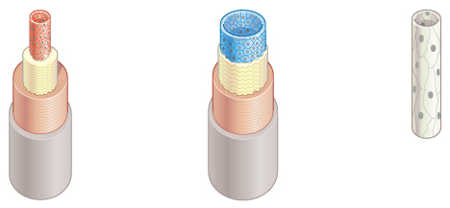
Unit 2: Chapter 13: Exchange and transport
13.6 Blood vessels and their functions:
What are the structures of arteries, arterioles and veins?
How is the structure of each of the above vessels related to its function?
What is the structure of capillaries and how is it related to their function?
Key words: arteries; arterioles; veins; capillaries; muscle; endothelium; lumen; elastic layer; valves; hydrostatic pressure; ultrafiltration;
Label the blood vessels and their structures, stating the function of the structure and how this relates to the function of the blood vessel:
Explain the how tissue fluid is form and how it is circulated:

Slide 34
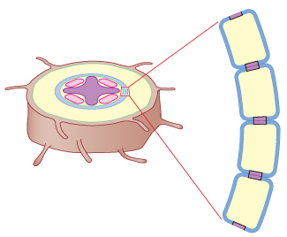
Unit 2: Chapter 13: Exchange and transport
13.7 Movement of water through roots:
How is water taken up be the root hairs?
How does water pass through the cortex of a root?
What are the apoplastic and symplastic pathways?
How is water passed through the endodermis into the xylem?
Key words:
root hairs; dicotyledonous; transpiration; water potential; cohesive; osmosis; carrier proteins; Casparian strip; endodermal cell; xylem; root pressure; cell wall; cytoplasm
Label the structures in a root hair
Explain how water moves through the plant via the apoplastic pathway:
Explain how water moves through the plant via the symplastic pathway:

Slide 35
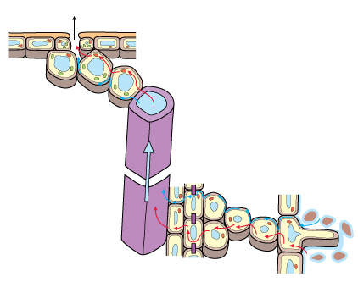
Unit 2: Chapter 13: Exchange and transport
13.8 Movement of water up stems:
What is transpiration?
How does water move through the leaf?
How does water move up the xylem?
Key words:
Osmosis; cohesive-tension theory; transpirational pull
Add labels to the diagram to explain the movement of water through the plant

Slide 36
Unit 2: Chapter 13: Exchange and transport
13.9 Transpiration and factors affecting it:
Why does transpiration occur?
How does external factors such as light, temperature, humidity and air movement affect transpiration?
Key words:
diffusion; light; temperature; humidity; potometer
What is transpiration?
Why does transpiration occur?
How does external factors affect transpiration?
Light:
Temperature
Humidity:
Air movement:

Slide 37
Unit 2: Chapter 13: Exchange and transport
13.10 Limiting water loss in plants:
How do terrestrial plants balance the need for gas exchange and the need to conserve water?
How do plants adapt to living in areas where water loss form transpiration may exceed their water intake?
What are xerophytic features?
Key words:
stomata; xerophytes; cuticle; water potential; transpiration
Describe how the features of a xerophytic plant reduce water loss:

Slide 38
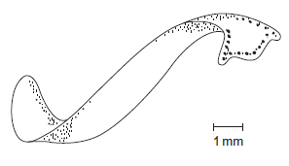
Unit 2: Chapter 13: Exchange and transport
Exam questions
A fish uses its gills to absorb oxygen from water. Explain how the gills of a fish are adapted for efficient gas exchange.
(6 marks)
The body of a flatworm is adapted for efficient gas exchange between the water and the cells inside the body.
Using the diagram, explain how two features of the flatworm’s body allow efficient gas
exchange.
1
2
(2 marks)

Slide 39
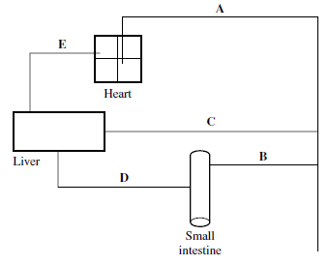
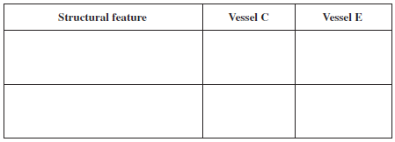
Unit 2: Chapter 13: Exchange and transport
Exam questions
The diagram shows some of the large blood vessels in a mammal.
Add arrows to the diagram to show the direction of blood flow in each of the blood vessels A-E
(1 mark)
Which of blood vessels A to E is the hepatic portal vein?
(1 mark)
Which of blood vessels A to E contains blood at low pressure?
(1 mark)
Complete the table to show two differences between the structure of vessel C and E
(2 marks)
Blood vessel B contains smooth muscle in its walls. Explain how this muscle may reduce the blood flow to the small intestine
(2 marks)
Elastic tissue in the wall of blood vessel A helps to even out the pressure of blood through this vessel. Explain how.
(2 marks)

Slide 40
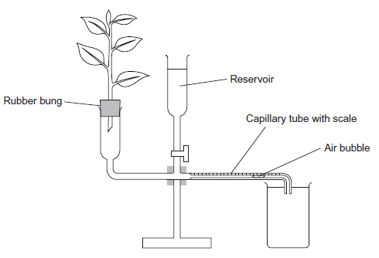
Unit 2: Chapter 13: Exchange and transport
Exam questions
A student investigated the rate of transpiration from a leafy shoot. She used a potometer to measure the rate of water uptake by the shoot. The diagram shows the potometer used by the student.
Give one environmental factor that the student should have kept constant during this investigation.
(1 mark)
The student cut the shoot and put it into the potometer under water. Explain why.
(1 mark)
The student wanted to calculate the rate of water uptake by the shoot in cm3 per minute. What measurements did she need to make?
(2 marks)
The student assumed that water uptake was equivalent to the rate of transpiration. Give two reasons why this might not be a valid assumption.
1.
2.
(2 marks)

Slide 41
Unit 2: Chapter 14: Classification
14.1 Classification:
What is a species?
How are species named?
What are the principles of classification?
How is classification related to evolution?
Key words:
ecological niche; gene pool; binomial system; generic name; classification; taxonomy; artificial; natural; kingdom; phylum; class; order; family; genus; species; phylogeny;
What do organisms in the same species have in common?
What are the principles of classification?
How are species named?
How are the taxonomic groups organised?

Slide 42
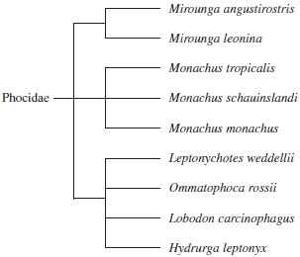
Unit 2: Chapter 14: Classification
Exam questions
An order is a taxonomic group. All seals belong to the same order. Name one other taxonomic group to which all seals belong.
(1 mark)
The diagram shows how some species of seal are classified.
How many different genera are shown in this diagram?
(1 mark)
All the seals shown in the diagram are members of the Phocidae. Phocidae is an example of a taxonomic group. Of which taxonomic group is it an example?
(1 mark)
The diagram is based on the evolutionary history of the seals. What does the information in the diagram suggest about the common ancestors of Mirounga angustirostris, Mirounga leonina and Monachus tropicalis?
(1 mark)

Slide 43
Unit 2: Chapter 15: Evidence for relationships between organisms
15.1 Genetic comparisons using DNA and proteins:
How can comparisons of base sequences in DNA be used to investigate how closely related organisms are?
What is DNA hybridisation and how is it used to determine relationships between organisms?
How can comparisons of amino acid sequences in proteins be used to investigate the relationships between organisms?
How are immunological comparisons used to investigate variations in proteins?
Key words:
enzymes; species; DNA hybridisation; immunological comparisons; antigen; serum; relationship
How can we compare DNA base sequences?
How can we use DNA base sequencing to classify organisms?
Explain DNA hybridisation:
How are immunological comparisons used to investigate variations in proteins?

Slide 44
Unit 2: Chapter 15: Evidence for relationships between organisms
15.2 Courtship behaviour:
What is the role courtship in ensuring successful mating?
How does courtship help members of a species recognise each other?
Key words:
courtship; behaviour; pair bond; synchronised mating;
What is the role courtship in ensuring successful mating?
How does courtship help members of a species recognise each other?

Slide 45
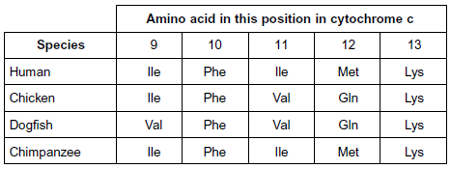
Unit 2: Chapter 15: Evidence for relationships between organisms
Exam questions
Cytochrome c is a protein found in all eukaryotes. In humans it consists of 102 amino acids. Biologists have compared the amino acid sequence in some other species with that in humans. The table shows amino acids 9 to 13 in the amino acid sequences of cytochrome c from four species.
What do the results suggest about the relationship between humans and the other three species?
(2 marks)
Suggest one advantage of using cytochrome c to determine relationships between species.
(1 mark)
Comparing the base sequence of a gene provides more information than comparing the amino acid sequence for which the gene codes. Explain why.
(2 marks)

Slide 46
Unit 2: Chapter 15: Evidence for relationships between organisms
Exam questions
Cranes are large birds. One of the earliest methods of classifying cranes was based on the calls they make during the breeding season.
Explain why biologists could use calls to investigate relationships between different species of crane.
(2 marks)
In hummingbirds throat colour is important in courtship. Explain the evidence in the table that shows that the crimson topaz and the fiery topaz may be different species of hummingbird.
(2 marks)

Slide 47
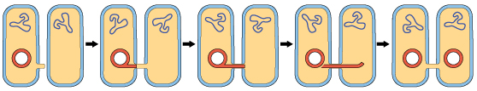
Unit 2: Chapter 16: Adaptation and selection
16.1 Genetic variation in bacteria:
What is the genetic material in bacteria?
How does variation arise in bacteria?
What are mutations?
How does conjugation occur?
Key words:
adaptation; antibiotics; antibiotic resistance; mutation; conjugation; horizontal gene transfer; vertical gene transfer;
Explain the two ways in which variation occurs in bacteria?
Mutation:
Conjunction:

Slide 48
Unit 2: Chapter 16: Adaptation and selection
16.2 Antibiotics:
What are antibiotics and how do they work?
How do bacteria become resistant to antibiotics?
How is resistance passed on to subsequent generations and other species?
Key words:
osmotic lysis; allele; plasmid
Describe what an antibiotic is and how it works:
Explain how bacteria become resistant to antibiotics and state how this resistance is passed:

Slide 49
Unit 2: Chapter 16: Adaptation and selection
16.3 Antibiotic use and resistance:
How do strains of bacteria emerge that are resistant to many drugs?
What are the implications of using antibiotics frequently?
What are the problems in treating tuberculosis and MRSA?
Key words:
transmission;
Describe antibiotic resistance using tuberculosis as an example of a resistant bacterium:
Describe antibiotic resistance using MRSA as an example of a resistant bacterium:

Slide 50
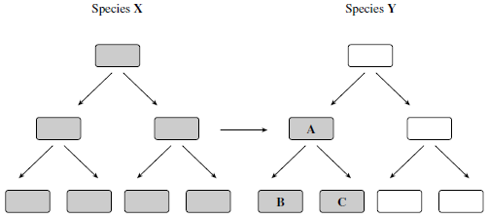
Unit 2: Chapter 16: Adaptation and selection
Exam questions
Give one way in which a DNA molecule in a prokaryote, such as a bacterium, is different from a DNA molecule in a eukaryote.
(1 mark)
Species X and Y are bacteria. The diagram shows gene transfer between bacteria in these two species. The bacteria that are shaded are resistant to the antibiotic penicillin.
Use the diagram to explain why bacterium A is resistant to penicillin.
(3 marks)
Use the diagram to explain why bacteria B and C are resistant to penicillin.
(2 marks)

Slide 51
Unit 2: Chapter 16: Adaptation and selection
Exam questions
The number of patients infected with the bacterium MRSA has increased in some hospitals. Scientists have suggested ways to reduce the transmission of MRSA in hospitals. Suggest two ways to reduce the transmission of MRSA in hospitals.
1
2
(2 marks)
The minimum inhibitory concentration (MIC) is the lowest concentration of a substance that prevents the growth of a microorganism. When antibiotics are prescribed for treating patients, higher doses than the MIC are recommended. Suggest two reasons why.
1
2
(2 marks)

Slide 52
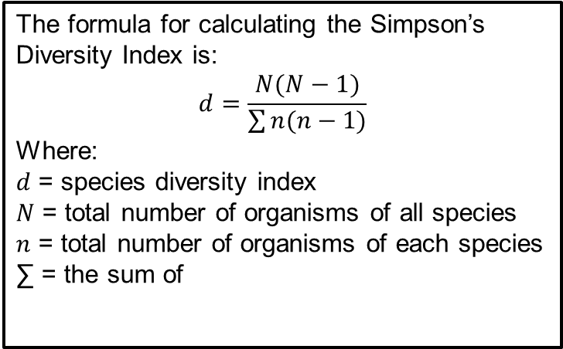
Unit 2: Chapter 17: Biodiversity
17.1 Species diversity:
What do we understand by species diversity?
How is Simpson’s Diversity Index used as a measure of species diversity?
Key words:
species diversity; genetic diversity; ecosystem diversity; species diversity index
What it species diversity and why is it important?
The formula for calculating the Simpson’s Diversity Index is:
$$d=\frac{N(N−1)}{\sum{n(n−1)}}$$
Where:
$d$ = species diversity index
$N$ = total number of organisms of all species
$n$ = total number of organisms of each species
∑ = the sum of
Calculate the species diversity index using the following numbers:
Species | Numbers (n) | n(n-1)
A | 4
B | 5
C | 6
 | ∑n(n-1)

Slide 53
Unit 2: Chapter 17: Biodiversity
17.2 Species diversity and human activities:
What is the influence of deforestation and the impact of agriculture on species diversity?
Key words:
communities; ecosystems; alleles; biomass; deforestation; agriculture
Describe how deforestation impacts on species diversity:
Describe how agriculture impacts on species diversity:

Slide 54
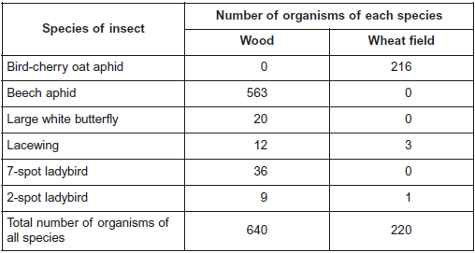
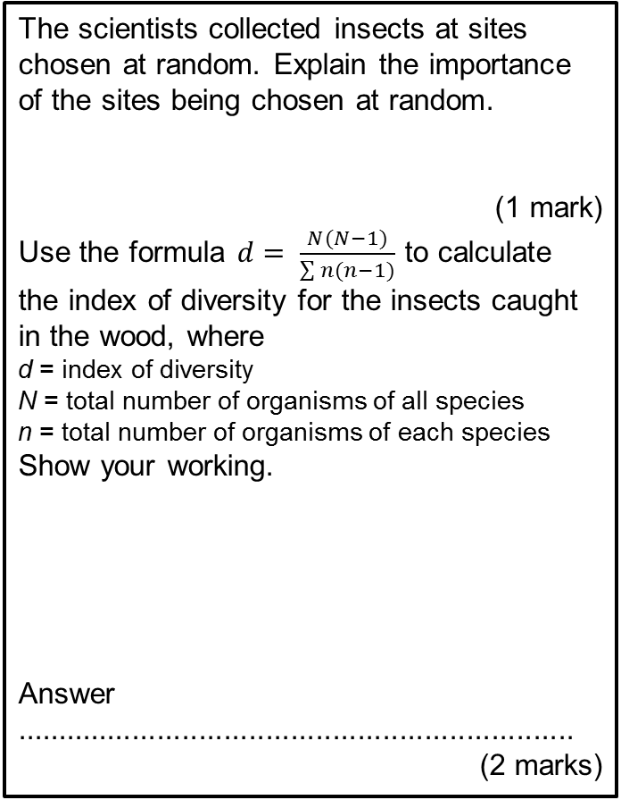
Unit 2: Chapter 17: Biodiversity
Exam questions
Scientists investigated the species of insects found in a wood and in a nearby wheat field. The scientists collected insects by placing traps at sites chosen at random both in the wood and in the wheat field. The table shows the data collected in the wood and in the wheat field.
The scientists collected insects at sites chosen at random. Explain the importance of the sites being chosen at random.
(1 mark)
Use the formula $d= \frac{N(N−1)}{\sum{n(n−1)}}$ to calculate the index of diversity for the insects caught in the wood, where
d = index of diversity
N = total number of organisms of all species
n = total number of organisms of each species
Show your working.
Answer ...................................................................
(2 marks)

Slide 55
Unit 2: Chapter 17: Biodiversity
Exam questions
Without carrying out any further calculations, estimate whether the index of diversity for the wheat field would be higher or lower than the index of diversity for the wood. Explain how you arrived at your answer.
(2 marks)
A journalist concluded that this investigation showed that farming reduces species diversity.
Evaluate this conclusion.
(2 marks)
Farmers were offered grants by the government to plant hedges around their fields. Explain the effect planting hedges could have on the index of diversity for animals.
(2 marks)

Slide 56
More exam questions
June 2009
Question 1 – Chapter 13
Question 2 – Chapter 8
Question 3 – Chapter 16
Question 4 – Chapter 11
Question 5 – Chapter 12 & 10
Question 6 – Chapter 14 & 9
Question 7 – Chapter 15
Question 8 – Chapter 13 & 15
Question 9 – Chapter 7 & 17
June 2011
Question 1 – Chapter 12 & 10
Question 2 – Chapter 9
Question 3 – Chapter 8
Question 4 – Chapter 11
Question 5 – Chapter 13
Question 6 – Chapter 10 & 13
Question 7 – Chapter 15
Question 8 – Chapter 17
Question 9 – Chapter 10
Question 10 – Chapter 16
June 2010
Question 1 – Chapter 10
Question 2 – Chapter 13
Question 3 – Chapter 8 & 11
Question 4 – Chapter 13
Question 5 – Chapter 8
Question 6 – Chapter 15
Question 7 – Chapter 10
Question 8 – Chapter 16
Question 9 – Chapter 10
June 2012
Question 1 – Chapter 12, 10 & 13
Question 2 – Chapter 10 & 17
Question 3 – Chapter 10
Question 4 – Chapter 11
Question 5 – Chapter 8
Question 6 – Chapter 14, 7 & 15
Question 7 – Chapter 17
Question 8 – Chapter 13
Question 9 – Chapter 16

