Slide 1
B1 REVISION – CHAPTER 4 – ADAPTATION FOR SURVIVAL
How are plants adapted to different environments?
How are animals adapted to different environments?
What do plants compete for and why?
What do animals compete for and why?
How can plants and animals be used to measure environmental change?
KEY WORDS:
Adaptations
Carnivore
Herbivore
Extremophiles
Surface area : volume ratio
Stomata
Respiration
Competition
Territory
ASSESSMENT:

Slide 2
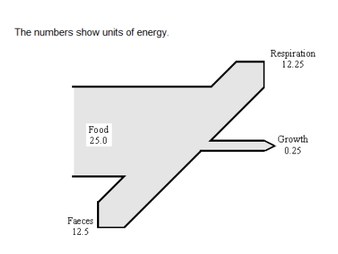
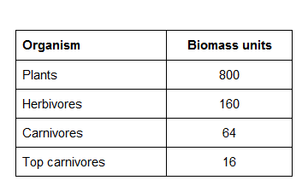
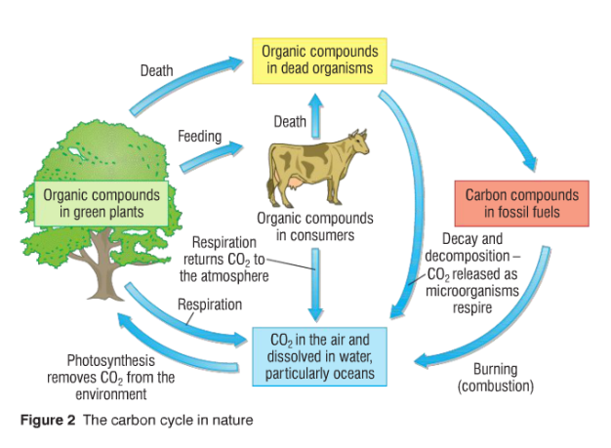
B1 REVISION – CHAPTER 5 – ENERGY IN BIOMASS
What is a pyramid of biomass?
Sketch a pyramid of biomass for this food chain:
Fill in this Sankey diagram to show energy loss:
Show your working here:
Faeces:
What is are the conditions needed for decay?
How does the decay process recycle nutrients?
Fill in the gaps in the carbon cycle
KEY WORDS:
Biomass
Pyramid of Biomass
Decomposers
Detritus feeders
Sewage treatment plants
Compost heap
Fossil fuels
Carbon cycle
Combustion
Organic waste
Green house gases
ASSESSMENT:

Slide 3
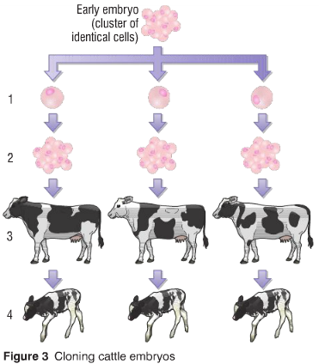
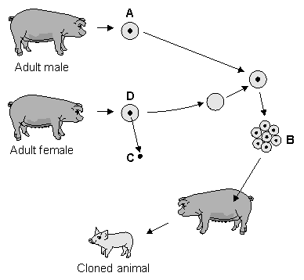
B1 REVISION – CHAPTER 6 – VARIATION, REPRODUCTION & NEW TECH
Define these key words:
Inheritance:
Genes:
Chromosomes:
DNA:
What is nature versus nurture?
Explain these two types of cloning:
Embryonic Cloning:
Adult Cell Cloning:
Fill in the gaps to explain genetic engineering of insulin:
The first step in the biotechnological process is that a special enzyme is used to cut the insulin ..................................... out from a human ............................................. . In a separate operation, a ring of bacterial ............................................... is cut open using a special enzyme. These two pieces of genetic material are combined together to form a new plasmid ring which is inserted into a bacterium.
What is sexual reproduction?
What is asexual reproduction?
KEY WORDS:
Genes
Gametes
Chromosomes
DNA
Sexual / asexual reproduction
Clones
Tissue culture
Genetically modified
Genetic engineering
ASSESSMENT:

Slide 4
B1 REVISION – CHAPTER 7 – EVOLUTION
What is the theory of evolution?
What is classification?
What is Jean-Baptiste Lamarck’s theory of evolution?
What an evolutionary tree?
What is Charles Darwin’s theory of evolution?
Explain how the peppered moth shows evolution in action?
What is survival of the fittest?
KEY WORDS:
Evolution
Jean-Baptiste Lamarck
Inheritance of acquired characteristics
Charles Darwin
Survival of the fittest
Mutation
Classification
Natural selection
Kingdoms
Species
ASSESSMENT:

